Slide 1
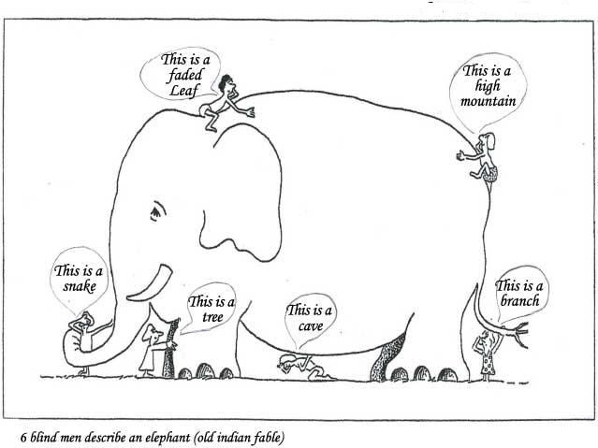
Teamwork The whole is greater than the sum of its parts
Notes:
Inspire people to work together
6 blind men and an Elephant (metaphor): http://www.jainworld.com/literature/story25.htm
The whole is greater than the sum of its parts

Slide 2
Essential Scrum

Slide 3
Essential Scrum
Intro
Team
Ceremonies
Artifacts

Slide 4
Essential Scrum
Intro
Traditional vs Scrum/Agile
Scrum history
Is more than Scrum
Team
Ceremonies
Artifacts

Slide 5
Traditional approach
Waterfall mindset – usually, everybody is looking for his part in the project, concentrating only on inputs and outputs of his layer, sometimes forgetting the end goal or the context he is operating in.
End Goal
Requirements
Analysts
- output and input
Project Managers
Architecture
& Design
Architects
late/missing feedback -
Development
associated roles
Programmers
- command and control
Software Testing
Testers
Release & Support
Supporters
Notes:
On the left is how waterfall looks like by the books. The traditional software development life cycle is highly process-centric. [Note: The model implies that you should attempt to complete a given stage before moving on to the next stage. That’s why feedback loop is merely missing or is late.] Management style is characterized by high formalization and standardization. People with different specializations are assigned roles for producing defined outcomes. And what people see when they get shown these boxes is shown on the right. Roles, what’s my part, you know? Usually, in traditional approach, team members have roles and are working in isolation at independent tasks/project modules without caring the others and what happens near him. And this is what Endava wants to avoid happening in the company and in the projects. Endava wants to avoid the waterfall mindset.
These functional groups (architects, programmers, testers), while great at internal communication don’t do much for eliminating friction and political barriers that can exist between the groups, i.e. “who said you could task a member of my group without my approval.” The worst thing never said about waterfall, is that impregnates the idea that the development process has an underlying hierarchy of roles. And as it happens in any hierarchy, nobody wants to be at the bottom.
Robert C. Martin, one of the first promoters and proponents of Agile, wrote in one of his article that by the middle of the 1990s, the waterfall process dominated the world of software. The field of Software Engineering was defined by it; and by the catalog of analysis and design documents that Architects, Designers, and Analysts were expected to produce. Coding was a detail — the least important part of the process. This attitude created a schism in the technical community. There were the elite Architects, Designers, and System Analysts who did the real engineering by satisfying the first two phases of the waterfall. And then there were the others who actually had to make everything work in the final phase. When the project got behind schedule, it was the development team who worked overtime. When the project failed, it was the developers who were blamed.
The attitudes of elitism were very real. Those who could analyze and design were considered too valuable to waste on mere coding. Code became the orphaned child of Software Engineering. By 1998, programmers everywhere were starting to reject the elitism of the Architects, Analysts, and Designers. They started complaining about the rigidity and weight of the waterfall methodology. And this is one of the main causes that led to appearance of Agile. [And we already know when and how agile manifesto appeared.]
In addition, The way people are organized, managed, and controlled in traditional approach is through "high command and control," a formalized and standardized approach. The manager is given responsibility and authority over all decisions and plans.
Source:
http://blog.guillermowinkler.com/blog/2012/09/02/waterfall-is-a-mindset/
https://gist.github.com/joshwand/710960, What Killed Waterfall could Kill Agile, Robert C. Martin, 2010
http://www.scrumalliance.org/community/articles/2013/january/traditional-and-agile-methods-an-interpretation
Robert C. Martin
Robert Cecil Martin (born 1952), known colloquially as "Uncle Bob“, is an American software consultant and author. Martin has been a software professional since 1970 and an international software consultant since 1990. In 2001, he initiated the meeting of the group that created Agile Manifesto. He is also a leading member of the software craftsmanship movement.

Slide 6
Agile approach
Agile mindset – team members, with skills across all layers, work collaboratively, doing their best in any circumstance, adapting in order to achieve the common end goal.
End Goal
Plan
Sprint 1
Analysis
& Planning
Sprint 2
Analysis
& Planning
Sprint 3
Analysis
& Planning
Sprint n
Analysis
& Planning
Sprint n+1
Architecture
& Design
Architecture
& Design
Architecture
& Design
Architecture
& Design
Coding
Coding
Coding
Coding
Testing
Testing
Testing
Testing
Release
Release
Release
Release
intern
intern
intern
intern
Gained additional knowledge
extern
extern
extern
extern
Notes:
Agile development requires a different approach to how teams are organized. The traditional approach to team organization doesn’t help the concept of Agile in which team communication is paramount to the success of an Agile project. Teamwork is a crucial part of Agile software development. It is when team members work collaboratively, trying their best in any circumstance, in order to achieve a common goal. Teamwork means that people will try to cooperate, using their individual skills and providing constructive feedback, despite any personal conflict between individuals.
In Agile, individuals do not really have to be assigned with predefined roles. The competencies of the individual are important and how they fit into the balance of the team. In Agile we need to move away from role descriptions and embrace the individuals skill set and competencies in order that we have a good blend of these to make up the team as a whole, so that it is capable of multi-functioning and which target the end goal.
An ‘ideal’ Agile Team is made up of persons who can: Analyse, Design, Code, Test, Manage (themselves), Plan, Estimate, Decide.
Source:
Scrum Guide
Certified Agile Tester manual, version 2.1
Ken Schwaber – Agile Project Management with Scrum
http://www.slideshare.net/GeorgePsistakis/features-overprojects?qid=a6121092-09cd-45ca-931e-098049ad79d0&v=default&b=&from_search=3#

Slide 7
Essential Scrum
Intro
Traditional vs Scrum/Agile
Scrum history
Is more than Scrum
Team
Ceremonies
Artifacts

Slide 8
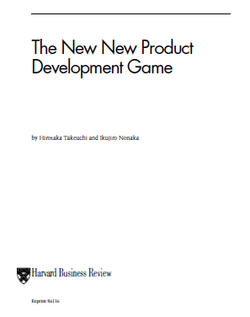





Scrum History
1986: Japanese scientists Nonaka and Takeuchi publish “The New New Product Development Game” in the Harvard Business Review. In it the authors use scrum from rugby as a metaphor to describe the concept of successful product development.
1991: In “Wicked Problems, Righteous Solutions” by P. DeGrace and L. Stahl, Scrum approach is mentioned.
1995: Jeff Sutherland and Ken Schwaber described and presented Scrum at Object-Oriented Programming Systems, Languages, and Applications Conference (OOPSLA) in Austin, Texas.
1999: Scrum as an organizational and process patterns published (Scrum : A Pattern Language for Hyper-productive Software Development).
2002: ScrumAlliance.org is founded by Ken Schwaber, Mike Cohn and Esther Derby.
2009: Ken Schwaber founded Scrum.org. In close collaboration with Jeff Sutherland, Scrum.org maintains the “Scrum Guide” in 30 languages.
Notes:
Scrum origins can be traced back to Japan where the term was applied to describe an accelerated development process brought about by a response to the competitiveness in manufacturing as a result of globalisation. Takeuchi and Nonaka are Godfathers of the Scrum Agile Process since they coined the term in their seminal paper in the Harvard Business Review in 1986: Takeuchi H. and I. Nonaka, “The New New Product Development Game”, Harvard Business Review, 1986 (January-February).
The term “scrum” was the analogy used to describe a better approach to product development in which the “team tries to go the distance as a unit, passing the ball back and forth”. The rugby comparison was made when they looked at the “relay race approach to product development – exemplified by NASA’s phased program planning system” in which they note that the rugby approach “may better serve today’s competitive requirements”.
Later, the term “Scrum” was used in Wicked Problems, Righteous Solutions (1991, DeGrace and Stahl) relating successful development to the game of Rugby in which a self-organizing team moves together down the field of product development.
In 1993, Jeff Sutherland while working at Easel Corporation had read “The New New Product Development Game” in the Harvard Business Review. Inspired by the article he created the first Scrum team that worked on development of Object Studio. Jeff Sutherland was the Chief Engineer for the Object Studio team that defined Scrum roles, hired the first Product Owner and ScrumMaster, developed the first Product Backlog and Sprint Backlog and built the first portfolio of products created with Scrum. Their product, Object Studio, was reported as industry leader by computer trade journals. Little did they know that Scrum would be their greatest contribution.
Object Studio: An object-oriented client/server development system, which is the primary toolset feature of the Smalltalk software suite of products from Cincom Systems, Inc., Cincinnati, OH (www.cincom.com). Supporting Windows, OS/2, Unix and the major databases, its Synchronicity module is used to graphically diagram the data and business logic and generate Enfin Smalltalk code. A visual programming tool is used to create the user interfaces. ObjectStudio was originally developed by Easel Corporation, which was acquired by VMARK Software. ObjectStudio was then sold to Cincom.
(Source: http://www.answers.com/topic/objectstudio)
In 1995, Jeff introduced the Scrum team to Ken Schwaber, CEO of Advanced Development Methods. Ken agreed that Scrum was a better way to build software than traditional methods used at IBM and the big eight consulting firms and worked with Jeff to formalize the Scrum development process at OOPSLA’95. In the same year, Sutherland provided support for development of eXtreme Programming by giving Kent Beck all background information on the creation of Scrum and the results of two years of product development with the Scrum process from 1993-95. XP engineering practices evolved along with Scrum and the two leading Agile development processes work well together. Scrum and XP are the most widely used Agile practices worldwide and their creators are signatories of the Agile Manifesto.
Scrum has made its way through the Pattern Languages of Programming Design (PLoP) process. Both Scrum and eXtreme Programming were affected by the software patterns movement and Mike Beedle, a Scrum signatory of the Agile Manifesto, led the effort to formally codify Scrum as an organizational pattern. His work was published in Volume 4 of Pattern Languages of Program Design in 1999.
In 2002, Ken Schwaber, Mike Cohn and Esther Derby founded ScrumAlliance.org. There they created the Certified Scrum Master programs and its derivatives. Ken left the Scrum Alliance in the fall of 2009 after a serious bicycle accident. He then founded Scrum.org. At Scrum.org, he led the development of new courseware, assessments, and partnerships to improve the quality and effectiveness of Scrum. In close collaboration with Jeff Sutherland, Scrum.org maintains the “Scrum Guide” in 30 languages.
Works:
Schwaber, Ken (1 February 2004). Agile Project Management with Scrum. Microsoft Press. ISBN 978-0-7356-1993-7.
Schwaber, Ken; Beedle, Mike (18 February 2002). Agile Software Development with Scrum. Prentice Hall. ISBN 978-0-13-067634-4.
Schwaber, Ken (2007). The Enterprise and Scrum. Microsoft Press. ISBN 978-0-7356-2337-8.
Schwaber, Ken; Sutherland, Jeff (2012). Software in 30 Days: How Agile Managers Beat the Odds, Delight Their Customers, And Leave Competitors In the Dust. Wiley. ISBN 978-1118206669.
http://en.wikipedia.org/wiki/Ken_Schwaber
http://jeffsutherland.com/ScrumPapers.pdf

Slide 9
Essential Scrum
Intro
Traditional vs Scrum/Agile
Scrum history
Is more than Scrum
Team
Ceremonies
Artifacts

Slide 10
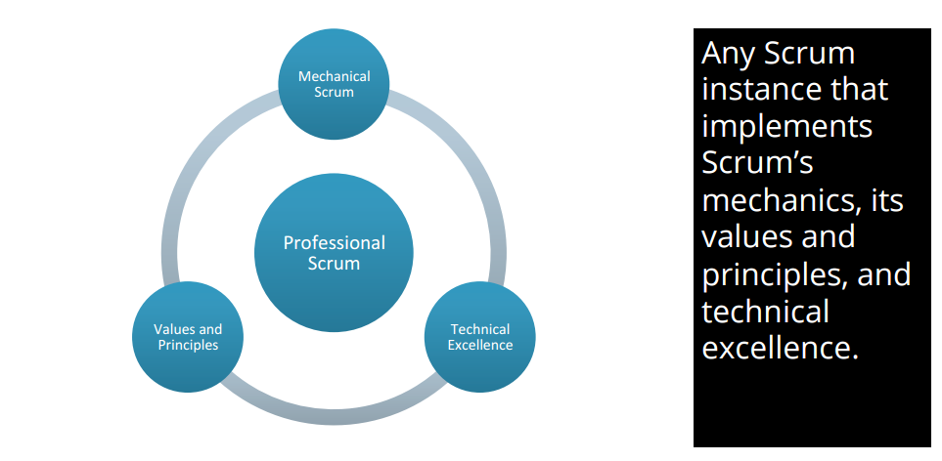
Is more than Scrum
Notes:
In Professional Scrum we not only follow the framework, but we enact the values and principles of the philosophy.
MECHANICAL SCRUM: IT’S A START Mechanical Scrum is easy. All we have to do is to follow the framework and use the terminology. This is where most organisations start and unfortunately, where they fi nish. They think to themselves, “How do we satisfy the demand that we do Scrum, but not have to change actually?”.
VALUES & PRINCIPALS: START TO LIVE THE DREAM There are fi ve values that go with Scrum; commitment, focus, openness, respect, and courage. They should be applied to all aspects of the process, so they have different meanings depending on the situation.
Along with the values, there are three principals that should be adhered to, time boxing, self-organising teams, and shippable code.
TECHNICAL EXCELLENCE: BE THE BEST Even when organisations focus on the values and principals they often forget about technical excellence. You need to train your Development Team members in the technology and the tools to make them effective. They might need to brush up their skills in patterns and practices to allow the most fl exible and relevant architecture emerge as they are building. Technical excellence is more than just having some skills, even if they are awesome skills. It’s about striving, at all times, to be the best at what you do.
Source: http://www.ndcmagazine.com/wp-content/uploads/2015/05/NDC-Magazine-1-2015.pdf

Slide 11
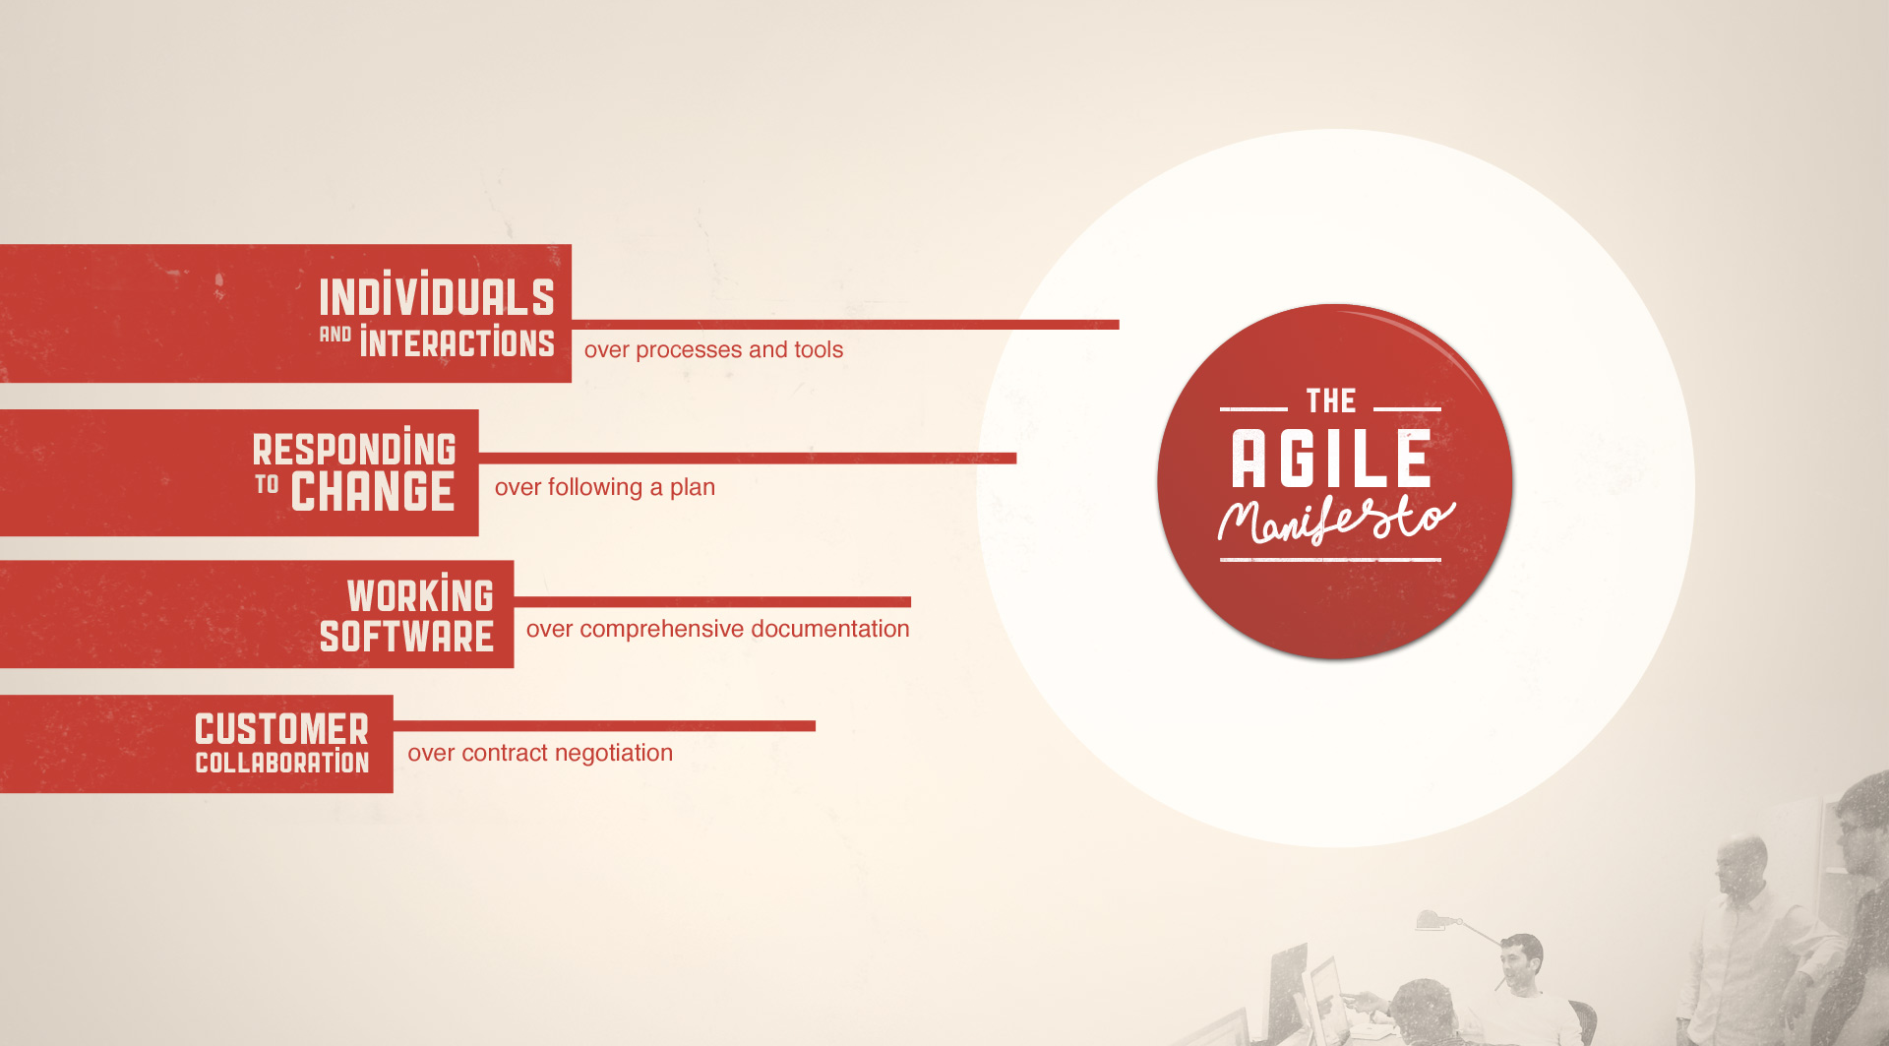
Notes:
http://agilemanifesto.org/history.html
On February 11-13, 2001, at The Lodge at Snowbird ski resort in the Wasatch mountains of Utah, seventeen people met to talk, ski, relax, and try to find common ground�and of course, to eat. What emerged was the Agile �Software Development� Manifesto. Representatives from Extreme Programming, SCRUM, DSDM, Adaptive Software Development, Crystal, Feature-Driven Development, Pragmatic Programming, and others sympathetic to the need for an alternative to documentation driven, heavyweight software development processes convened.
Please read this article also that explain what does the manifesto mean: http://www.scrumalliance.org/community/articles/2013/2013-april/what-does-the-agile-manifesto-mean
http://msdn.microsoft.com/en-us/library/dd997578.aspx
Individuals and Interactions
Individuals and interactions are essential to high-performing teams. Studies of "communication saturation" during one project showed that, when no communication problems exist, teams can perform 50 times better than the industry average. To facilitate communication, agile methodologies rely on frequent inspect-and-adapt cycles. These cycles can range from every few minutes with pair programming, to every few hours with continuous integration, to every day with a daily standup meeting, to every iteration with a review and retrospective.
Just increasing the frequency of feedback and communication, however, is not enough to eliminate communication problems. These inspect-and-adapt cycles work well only when team members exhibit several key behaviors:
respect for the worth of every person
truth in every communication
transparency of all data, actions, and decisions
trust that each person will support the team
commitment to the team and to the team’s goals
To foster these types of behavior, agile management must provide a supportive environment, team coaches must facilitate their inclusion, and team members must exhibit them. Only then can teams achieve their full potential.
For teams to achieve these types of behavior is more difficult than it might appear. Most teams avoid truth, transparency, and trust because of cultural norms or past negative experiences from conflict that was generated by honest communications. To combat these tendencies, leadership and team members must facilitate positive conflict. When teams engage in positive conflict, they not only foster more productive behavior, but also work to achieve several other benefits:
Process improvement depends on the team to generate a list of impediments or problems in the organization, to face them squarely, and then to systematically eliminate them in priority order.
Innovation occurs only with the free interchange of conflicting ideas, a phenomenon that was studied and documented by Hirotaka Takeuchi and Ikujiro Nonaka, the godfathers of Scrum.
Resolution of conflicting agendas occurs when teams align around common goals and surface their concerns and potential conflicts.
Commitment to work together happens only when people agree on common goals and then struggle to improve both personally and as a team.
This last bullet, about commitment, is especially important. It is only when individuals and teams are committed that they feel accountable for delivering high value, which is the bottom line for software development teams. Agile methodologies facilitate commitment and self-organization by encouraging team members to pull items from a prioritized work list, manage their own work, and focus on improving their work practices. These practices form the basis of self-organization, which is the driving force for achieving results in an agile team.
To create high-performing teams, agile methodologies value individuals and interactions over processes and tools. Practically speaking, all of the agile methodologies seek to increase communication and collaboration through frequent inspect-and-adapt cycles. However, these cycles work only when agile leaders encourage the positive conflict that is needed to build a solid foundation of truth, transparency, trust, respect, and commitment on their agile teams.
Working Software over Comprehensive Documentation
Working software is one of the big differences that agile development brings. All of the agile methodologies that are represented in the Agile Manifesto stress delivering small pieces of working software to the customer at set intervals.
All agile teams must establish what they mean when they say "working software," which is frequently known as the definition of done. At a high level, a piece of functionality is complete only when its features pass all tests and can be operated by an end user. At a minimum, teams must go beyond the unit test level and test at the system level. The best teams also include integration testing, performance testing, and customer acceptance testing in their definition of what it means to be done with a piece of functionality.
One CMMI Level 5 company, that already has one of the lowest defect rates in the world, has shown through extensive data on many projects the benefits of agile practices. Specifically, they were able to systematically double the speed of production and reduce defects by 40 percent by taking the following actions:. This from a company.
Define acceptance tests when defining the feature.
Implement features serially and in priority order.
Run acceptance tests on each feature as soon as they are implemented.
Fix bugs that are identified as highest priority as soon as possible.
The Agile Manifesto recommends that teams deliver working software at set intervals. By agreeing as a team on what success means is one of the practical ways that agile teams bring about the high performance and high quality that is needed to accomplish this goal.
Customer Collaboration over Contract Negotiation
Over the past two decades, project success rates have more than doubled worldwide. These improvements occurred as a result of smaller projects and more frequent deliveries, which allowed customers to provide feedback on working software at regular intervals. The writers of the manifesto were clearly on to something when they stressed that getting the customer involved in the software development process is essential to success.
The agile methodologies foster this value by having a customer advocate work hand-in-hand with the development team. The first Scrum team, for example, had thousands of customers. Because it was not feasible to involve them all in product development, they selected a customer proxy, called a product owner. The product owner represented not only all the customers in the field, but also management, sales, support, client services, and other stakeholders. The product owner was responsible for updating the list of requirements every four weeks as the team released working software, taking into account the current reality and actual feedback from customers and stakeholders. Customers actively helped shape the software that was being created.
The first XP team began with an internal IT project. The XP team was able to have a company end user on their team work with them daily. About 10 percent of the time, consultants and internal teams can find an end user who can work with the team on a day-to-day basis. The other 90 percent of the time, they must appoint a proxy. This customer proxy, whom XP teams call the customer, works with end users to provide a clear, prioritized list of features for developers to implement.
It is through daily customer (or customer proxy) collaboration that industry data shows that agile projects have more than twice the success rate of traditional projects on average worldwide. Because agile methodologies recognize the value of customer engagement, they have created a place on their development teams that is specifically for the customer representative.
Responding to Change over Following a Plan
For teams to create products that will please customers and provide business value, teams must respond to change. Industry data shows that over 60 percent of product or project requirements change during the development of software. Even when traditional projects finish on time, on budget, with all features in the plan, customers are often unhappy because what they find is not exactly what they wanted. "Humphrey’s Law" says that customers never know what they want until they see working software. If customers do not see working software until the end of a project, it is too late to incorporate their feedback. Agile methodologies seek customer feedback throughout the project so that teams can incorporate feedback and new information as the product is being developed.
All agile methodologies have built-in processes to change their plans at regular intervals based on feedback from the customer or customer proxy. Their plans are designed to always deliver the highest business value first. Because 80 percent of the value is in 20 percent of the features, well-run agile projects tend to finish early, whereas most traditional projects finish late. As a result, customers are happier, and developers enjoy their work more. Agile methodologies are based on the knowledge that, in order to succeed, they must plan to change. That is why they have established processes, such as reviews and retrospectives, that are specifically designed to shift priorities regularly based on customer feedback and business value.

Slide 12
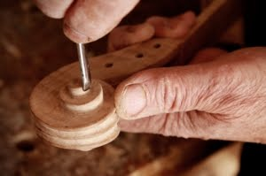
Strive for Technical Excellence
Wouldn’t it be nice if we were always so pleased with the quality of our code?
Test-driven development
Refactoring
Collective ownership
Continuous integration
Pair programming
Not only working software, but also well-crafted software
http://manifesto.softwarecraftsmanship.org/
Notes:
Succeeding with Agile, Mike Cohn
http://manifesto.softwarecraftsmanship.org/
Technical practices used by SCRUM teams to improve quality of their work:
Test-driven development
How programmers write code on a traditional development: they typically select a portion of the program to tackle, write the code, attempt to compile it, fix all the compile errors, walk through the code in a debugger, and then repeat. This process is very different from a test-driven approach. A programmer doing test-driven development works in very short cycles of identifying and automating a failing test, writing just enough code to pass that test, and then cleaning the code up in any necessary ways before starting again. This cycle is repeated every few minutes, rather than every few hours.
TDD ensures that no untested code makes it into the system. If all code must be written in response to a failing test, then if we do nothing else, we at least achieve full code coverage with TDD. You might think a test-right-after approach would achieve the same result. However, I’ve found that when programmers make a commitment to write their unit tests “right after” they finish implementing a feature, they often do not do so. The pressure to get started programming the next feature can be tremendous. So programmers tend to write tests for only a subset of the new functionality or put testing on a list of things to get to later, and then find that later never comes.
It is appropriate to think of TDD as being as much a design practice as a programming practice. The tests a programmer writes and the order in which they are written guide the design and development of a feature.
There is evidence that doing TDD takes about 15% longer than not doing TDD (George and Williams 2003). But there is also evidence that TDD leads to fewer defects. Two studies at Microsoft found that the number of bugs found went down by 24% and 38% with the use of TDD (Sanchez,Williams, and Maximilien 2007, 6). So, yes, TDD may take longer initially, but the time will come back to the team in the form of reduced bug fixing and maintenance time.
Refactoring
Refactoring refers to changing the structure but not the behaviour of code. Let me give you an example. Suppose a programmer has two methods that each contain three identical statements. These three common statements can be extracted from both methods and put into one new method that is called from both of the old locations. This refactoring (formally known as extract method) has slightly improved the readability and maintainability of the program because it is now more obvious that some code is reused and the duplicated code has been moved to a
single place. The structure of the code has been changed while its behaviour has not.
Collective ownership
Collective ownership refers to all developers feeling ownership over all artefacts of the development process, but especially of the code and automated tests. Because of the fast pace of a Scrum project, the team needs to avoid the trap of saying, ”That's Ted's code”. “We can’t touch it.” Collective ownership encourages each team member to feel responsible for all parts of the program so that any programmer can work on any module of the program. When modifying a module, the programmer then shares responsibility for its quality with the module’s initial writer.
Collective ownership is not intended to cause a free-for-all in the coding. Programmers will still tend to have certain areas they specialize in and prefer to work in, but everyone on the team shares the following responsibilities:
- Ensure that no developer becomes so specialized he can contribute only in one area.
- Make certain that no area becomes so intricate that it is understood and worked upon by only one developer.
Continuous integration
Creating an official nightly build of a product has been known as an industry best practice since at least the early 1990s. Well, if a nightly build is a good idea, building a product continuously is an even better one. Continuous integration refers to integrating new or changed code into an application as soon as possible and then testing the application to make sure that nothing has been broken. Rather than checking in code perhaps every few days or even every few weeks, each programmer on a Scrum team running continuous integration is expected to check in code a few times each day—and to run a suite of regression tests over the entire application.
Continuous integration is usually achieved with the help of a tool or script that notices when code has been checked into the version control system. Cruise Control was the first product to gain popularity for automating continuous integration. It could build a product, run as many tests as desired against it, and could then automatically send a notification to the developer who broke the build (or to the entire team). Cruise Control could also send build results to additional feedback devices such as lava lamps, ambient orbs, spare monitors, LED displays, and more.
Pair programming
Pair programming is the practice of having two developers work together to write code. It originated from the idea that if occasional code inspections are good, constant code inspections are better. Many of the practices just described are made easier through the use of pair programming. Learning how to do test-driven development is made easier when working together. Feelings of collective ownership
are created when code is produced in pairs. And having the discipline to leave the code cleaner than you found it comes easier when another developer is sitting beside you.

Slide 13

Scrum in a Nutshell
13
Notes:
Scrum hangs all of its practices on an iterative, incremental process skeleton. Scrum’s skeleton is shown on the slide. The lower circle represents
an iteration of development activities that occur one after another. The output of each iteration is an increment of product. The upper circle
represents the daily inspection that occurs during the iteration, in which the individual team members meet to inspect each others’ activities and
make appropriate adaptations. Driving the iteration is a list of requirements. This cycle repeats until the project is no longer funded.
The skeleton operates this way: At the start of an iteration, the team reviews what it must do. It then selects what it believes it can turn in to an
increment of potentially shippable functionality by the end of the iteration. The team is then left alone to make its best effort for the rest of the
iteration. At the end of the iteration, the team presents the increment of functionality it built so that the stakeholders can inspect the functionality and
timely adaptations to the project can be made.
The heart of Scrum lies in the iteration. The team takes a look at the requirements, considers the available technology, and evaluates its own skills
and capabilities. It then collectively determines how to build the functionality, modifying its approach daily as it encounters new complexities,
difficulties, and surprises. The team figures out what needs to be done and selects the best way to do it. This creative process is the heart of the
Scrum’s productivity.
Ken Schwaber – Agile Project Management with Scrum

Slide 14

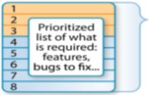
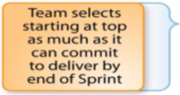







Scrum on a Page
Roles |  | Artefacts |  | Ceremonies
 | Product Owner Set Priorities Manage Product Backlog Scrum Master Teach Scrum Manage Process Protect Team Enforce Rules Remove Blocks The Build Team Develop Product Organize Work Update Progress |  | Product Backlog List of requirements Owned by the Product Owner Ordered by business value, dependency, risk Can change without affecting the active Sprint Sprint Backlog Decomposed task list Driven by a portion of Product Backlog Owned by Build Team Only Build Team modifies it Increment Version of the Product Potentially shippable Working functionality Tested & documented according to project definition of “Done” |  | Sprint Planning Part A Time-boxed at 2 hours Facilitated by Scrum Master Top of Product Backlog presented by Product Owner to Build Team Declare Sprint Goal Build Team asks questions and selects topmost features Part B Time-boxed at 2 hours Facilitated by Scrum Master Team decomposes selected features into a Sprint Backlog Team adjust + / - features by estimates against sprint capacity Daily Scrum Time-boxed to 15’ Facilitated by Scrum Master Build Team attends Same time / place every day Build Team updates Sprint Backlog Sprint Review Time-boxed to 2 hours Facilitated by Scrum Master Attended by all Informal meeting Agile Team presents the Done functionality and all discuss to optimize the Product Sprint Retrospective Time-boxed to 1 hour and a half Facilitated by Scrum Master Attended by Build Team and Product Owner Discuss process improvements, successes and failures Adjust process
Notes:
Roles
Product Owner
The Product Owner is responsible for maximizing the value of the product and the work of the Development Team. How this is done may vary widely across organizations, Scrum Teams, and individuals.
The Product Owner is the sole person responsible for managing the Product Backlog. Product Backlog management includes:
• Clearly expressing Product Backlog items;
• Ordering the items in the Product Backlog to best achieve goals and missions;
• Optimizing the value of the work the Development Team performs;
• Ensuring that the Product Backlog is visible, transparent, and clear to all, and shows what the Scrum Team will work on next; and,
• Ensuring the Development Team understands items in the Product Backlog to the level needed.
No one is allowed to tell the Development Team to work from a different set of requirements, and the Development Team isn’t allowed to act on what anyone else says
Scrum Master
The Scrum Master is responsible for ensuring Scrum is understood and enacted. Scrum Masters do this by ensuring that the Scrum Team adheres to Scrum theory, practices, and rules.
The Scrum Master is a servant-leader for the Scrum Team. The Scrum Master helps those outside the Scrum Team understand which of their interactions with the Scrum Team are helpful and which aren’t.
The Scrum Master serves the Product Owner in several ways, including:
• Finding techniques for effective Product Backlog management;
• Helping the Scrum Team understand the need for clear and concise Product Backlog items;
• Understanding product planning in an empirical environment;
• Ensuring the Product Owner knows how to arrange the Product Backlog to maximize value;
• Understanding and practicing agility; and,
• Facilitating Scrum events as requested or needed.
The Scrum Master serves the Development Team in several ways, including:
• Coaching the Development Team in self-organization and cross-functionality;
• Helping the Development Team to create high-value products;
• Removing impediments to the Development Team’s progress;
• Facilitating Scrum events as requested or needed; and,
• Coaching the Development Team in organizational environments in which Scrum is not yet fully adopted and understood.
The Scrum Master serves the organization in several ways, including:
• Leading and coaching the organization in its Scrum adoption;
• Planning Scrum implementations within the organization;
• Helping employees and stakeholders understand and enact Scrum and empirical product development;
• Causing change that increases the productivity of the Scrum Team; and,
• Working with other Scrum Masters to increase the effectiveness of the application of Scrum in the organization.
The Development Team
The Development Team consists of professionals who do the work of delivering a potentially releasable Increment of “Done” product at the end of each Sprint. Only members of the Development Team create the Increment.
Development Teams are structured and empowered by the organization to organize and manage their own work
Development Teams have the following characteristics:
• They are self-organizing. No one (not even the Scrum Master) tells the Development Team how to turn Product Backlog into Increments of potentially releasable functionality;
• Development Teams are cross-functional, with all of the skills as a team necessary to create a product Increment;
• Scrum recognizes no titles for Development Team members other than Developer, regardless of the work being performed by the person; there are no exceptions to this rule;
• Scrum recognizes no sub-teams in the Development Team, regardless of particular domains that need to be addressed like testing or business analysis; there are no exceptions to this rule; and,
• Individual Development Team members may have specialized skills and areas of focus, but accountability belongs to the Development Team as a whole
Fewer than three Development Team members decrease interaction and results in smaller productivity gains
Having more than nine members requires too much coordination.
Artefacts
Product Backlog
The Product Backlog is an ordered list of everything that might be needed in the product and is the single source of requirements for any changes to be made to the product. The Product Owner is responsible for the Product Backlog, including its content, availability, and ordering.
A Product Backlog is never complete. The earliest development of it only lays out the initially known and best-understood requirements. The Product Backlog evolves as the product and the environment in which it will be used evolves. The Product Backlog is dynamic; it constantly changes to identify what the product needs to be appropriate, competitive, and useful. As long as a product exists, its Product Backlog also exists.
The Product Backlog lists all features, functions, requirements, enhancements, and fixes that constitute the changes to be made to the product in future releases. Product Backlog items have the attributes of a description, order, estimate and value.
Sprint Backlog
The Sprint Backlog is the set of Product Backlog items selected for the Sprint, plus a plan for delivering the product Increment and realizing the Sprint Goal. The Sprint Backlog is a forecast by the Development Team about what functionality will be in the next Increment and the work needed to deliver that functionality into a “Done” Increment.
The Sprint Backlog makes visible all of the work that the Development Team identifies as necessary to meet the Sprint Goal.
The Sprint Backlog is a plan with enough detail that changes in progress can be understood in the Daily Scrum. The Development Team modifies the Sprint Backlog throughout the Sprint, and the Sprint Backlog emerges during the Sprint. This emergence occurs as the Development Team works through the plan and learns more about the work needed to achieve the Sprint Goal
Increment
The Increment is the sum of all the Product Backlog items completed during a Sprint and the value of the increments of all previous Sprints. At the end of a Sprint, the new Increment must be “Done,” which means it must be in useable condition and meet the Scrum Team’s definition of “Done.” It must be in useable condition regardless of whether the Product Owner decides to actually release it.
Ceremonies
Sprint Planning
The work to be performed in the Sprint is planned at the Sprint Planning. This plan is created by the collaborative work of the entire Scrum Team.
Sprint Planning is time-boxed to a maximum of eight hours for a one-month Sprint. For shorter Sprints, the event is usually shorter. The Scrum Master ensures that the event takes place and that attendants understand its purpose. The Scrum Master teaches the Scrum Team to keep it within the time-box.
Sprint Planning answers the following:
• What can be delivered in the Increment resulting from the upcoming Sprint?
• How will the work needed to deliver the Increment be achieved?
Daily Scrum
The Daily Scrum is a 15-minute time-boxed event for the Development Team to synchronize activities and create a plan for the next 24 hours. This is done by inspecting the work since the last Daily Scrum and forecasting the work that could be done before the next one. The Daily Scrum is held at the same time and place each day to reduce complexity. During the meeting, the Development Team members explain:
• What did I do yesterday that helped the Development Team meet the Sprint Goal?
• What will I do today to help the Development Team meet the Sprint Goal?
• Do I see any impediment that prevents me or the Development Team from meeting the Sprint Goal?
The Development Team uses the Daily Scrum to inspect progress toward the Sprint Goal and to inspect how progress is trending toward completing the work in the Sprint Backlog. The Daily Scrum optimizes the probability that the Development Team will meet the Sprint Goal
Sprint Review
A Sprint Review is held at the end of the Sprint to inspect the Increment and adapt the Product Backlog if needed. During the Sprint Review, the Scrum Team and stakeholders collaborate about what was done in the Sprint. Based on that and any changes to the Product Backlog during the Sprint, attendees collaborate on the next things that could be done to optimize value. This is an informal meeting, not a status meeting, and the presentation of the Increment is intended to elicit feedback and foster collaboration.
Sprint Retrospective
The Sprint Retrospective is an opportunity for the Scrum Team to inspect itself and create a plan for improvements to be enacted during the next Sprint.
The Sprint Retrospective occurs after the Sprint Review and prior to the next Sprint Planning. This is a three-hour time-boxed meeting for one-month Sprints. For shorter Sprints, the event is usually shorter. The Scrum Master ensures that the event takes place and that attendants understand its purpose. The Scrum Master teaches all to keep it within the time-box. The Scrum Master participates as a peer team member in the meeting from the accountability over the Scrum process.
The purpose of the Sprint Retrospective is to:
• Inspect how the last Sprint went with regards to people, relationships, process, and tools;
• Identify and order the major items that went well and potential improvements; and,
• Create a plan for implementing improvements to the way the Scrum Team does its work.
The Scrum Master encourages the Scrum Team to improve, within the Scrum process framework, its development process and practices to make it more effective and enjoyable for the next Sprint. During each Sprint Retrospective, the Scrum Team plans ways to increase product quality by adapting the definition of “Done” as appropriate.
By the end of the Sprint Retrospective, the Scrum Team should have identified improvements that it will implement in the next Sprint. Implementing these improvements in the next Sprint is the adaptation to the inspection of the Scrum Team itself. Although improvements may be implemented at any time, the Sprint Retrospective provides a formal opportunity to focus on inspection and adaptation

Slide 15
Essential Scrum
Intro
Team
Product Owner
Build Team
Scrum Master
Ceremonies
Artifacts

Slide 16
Scrum in a Nutshell
16
Notes:
Scrum hangs all of its practices on an iterative, incremental process skeleton. Scrum’s skeleton is shown on the slide. The lower circle represents
an iteration of development activities that occur one after another. The output of each iteration is an increment of product. The upper circle
represents the daily inspection that occurs during the iteration, in which the individual team members meet to inspect each others’ activities and
make appropriate adaptations. Driving the iteration is a list of requirements. This cycle repeats until the project is no longer funded.
The skeleton operates this way: At the start of an iteration, the team reviews what it must do. It then selects what it believes it can turn in to an
increment of potentially shippable functionality by the end of the iteration. The team is then left alone to make its best effort for the rest of the
iteration. At the end of the iteration, the team presents the increment of functionality it built so that the stakeholders can inspect the functionality and
timely adaptations to the project can be made.
The heart of Scrum lies in the iteration. The team takes a look at the requirements, considers the available technology, and evaluates its own skills
and capabilities. It then collectively determines how to build the functionality, modifying its approach daily as it encounters new complexities,
difficulties, and surprises. The team figures out what needs to be done and selects the best way to do it. This creative process is the heart of the
Scrum’s productivity.
Ken Schwaber – Agile Project Management with Scrum

Slide 17
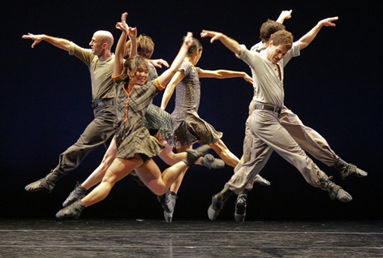
Scrum Team
Primary focus:
Deliver products iteratively and incrementally
Maximize opportunities for feedback
Ensure a potentially useful version of working product is always available
Members:
Product Owner points the team at the right goal
Build Team turns requirements into usable functionality with every Sprint
Scrum Master helps the team get to the target as efficiently as possible
Notes:
The Agile Team consists of a Product Owner, the Development Team, and a Scrum Master. The Agile team model is designed to optimize flexibility, creativity, and productivity by eliminating hierarchy and elitism.
Agile Teams deliver products iteratively and incrementally, maximizing opportunities for feedback. Incremental deliveries of “Done” product ensure a potentially useful version of working product is always available.
The first task for the Scrum Master is to find developers to form the Development Team. The people on this team need to have the skills to turn the needs
and requirements of the Product Owner (Product Backlog) into working increments of software with every Sprint. All members of the Agile Team get together for introductions, discuss the upcoming work, and lay out the logistics for working together. The Agile Team needs to know the vision (the needed and the hoped-for outcome), what outcomes would signify success and failure, and what the constraints are.
Becoming good at agile development is a little like learning to dance. Some of us are naturally born dancers and learn quickly and seemingly effortlessly. Others of us struggle for quite a while to get our two left feet coordinating effectively with the rest of the team. But natural or not, every team member needs to become good at the agile dance.
Source:
1. Software in 30 Days How Agile Managers Beat the Odds, Delight Their Customers, And Leave Competitors In the Dust, Jeff Sutherland and Ken Schwaber
2. https://www.scrum.org/Portals/0/Documents/Scrum%20Guides/2013/Scrum-Guide.pdf#zoom=100
3. http://www.scrumalliance.org/community/articles/2011/july/dancing-with-pigs
http://news.wwu.edu/posted/1538/Jangle_Photo_by_Sharen_Bradford_.244088.jpg
[Note for presenter: There is a clear distinction between two groups: those who have committed to the project and everyone else who is involved, engaged and interested in the project. Those who are responsible for the project have the authority to do what is necessary for its success and that ideas, desires and needs of other people (roles) are taken into account, but are not in any way affecting or distorting the project.]

Slide 18

Characteristics of an Scrum Team
Cross-functional: members with skills and competencies in each of the disciplines needed
Self-organized: ability to decide inside the team how best to accomplish work
Empowered: autonomy to plan and manage their own work
Accountable: responsibility to deliver a working piece of software at the end of the iteration
Notes:
In Agile, when it comes to build a team, we should seek to build a self-organized, empowered, cross-functional team.
1. When we can affirm that a team is cross-functional? When it has members with skills in each of the functional areas needed.
2. When a team is self-organized? When some form of order or coordination arises out of the local interactions, right? It’s when teams choose how best to accomplish their work, rather than being directed by others outside the team. Team members help each other to overcome obstacles that are within the team’s power to overcome.
3. And when a team is empowered? When the team has ownership over their work. Empowered teams have increased levels of responsibility and authority over the work that they do, giving them the autonomy to plan and manage work, make their own decisions and solve their own problems.
For example, in a boat race, team members rowing the boat operate collaboratively and focus towards reaching their goal. They are synchronized and maintain the rhythm, and everyone equally contributes.
Team accountability is also a critical aspect of an Agile team, as without it the Agile method will fail. Team members have personal accountability in what they deliver and what they commit to, and the team has accountability to delivering a working piece of software at the end of the iteration.
Source:
http://www.abdn.ac.uk/develop/managers/empowering-your-team-307.php
http://amj.aom.org/content/56/2/573.abstract
http://codedcomplex.com/2010/09/enabling-to-a-successful-team/
Certified Agile Tester manual, version 2.1

Slide 19
Essential Scrum
Intro
Team
Product Owner
Build Team
Scrum Master
Ceremonies
Artifacts

Slide 20
Product Owner
Primary focus:
Is the Navigator. Envisioning the product - Maximizing the value of the product
Single voice to make product decision
Maximizing the work of the development team
Responsibilities:
Manages Product Backlog focusing on What rather than How
Accountable for managing the Product Backlog even if he choses to delegate this activity
Represents all stakeholders: End Users, Senior Management, Operational Staff, Domain Experts, Architects, Auditors
Notes:
Roman Pichler, author of Agile Product Management with Scrum: Creating Products that Customers Love, stresses the importance of the product owner : “The product owner has the authority to set a goal and shape the vision. The product owner is not just a project manager who now also writes requirements and does a little bit of prioritization.” Thinking of the product owner as the provider of a team’s goal helps make certain aspects of the product owner’s job clear. For example, the product owner is clearly responsible for defining and prioritizing the product backlog that expresses the goal. Similarly, the product owner is responsible for making sure the project earns a good return on the investment made in it.
The product owner can never stop dancing. Coordinating and synthesizing the insights and needs of all stakeholders is often more than a fulltime job. To properly understand long term ROI and thus be able to optimally rank order the product backlog, the PO needs insight from business partners on value and insight from the technical team on cost. The product owner’s dance with the business stakeholders must be as continuous and intricate as the team interactions. As Iain McKenna points out, it is as much a mistake for the business partners to abdicate their product responsibilities as it is for the team to abdicate theirs. The PO must be the catalyst to drive the stakeholders’ creative input into the backlog.
For the Product Owner to succeed, the entire organization must respect his or her decisions. The Product Owner’s decisions are visible in the content and ordering of the Product Backlog. No one is allowed to tell the Development Team to work from a different set of requirements, and the Development Team isn’t allowed to act on what anyone else says.
Explanation of the triangle:
Scope is what the project is trying to achieve, it is the reason and the purpose of the project. Scope is the boundary of a project, it is what the beneficiaries, and the donors expect from the project, nothing more, and nothing less.
Schedule is defined as the time to complete the project. Decisions regarding the schedule duration can be taken by Product Owner (or on behalf of sponsors or chief executive). Control and monitoring of schedule usually is performed by Scrum Master in collaboration with the team and Product Owner.
People. We replaced cost or resources with people because when we are talking about resources, we are of course mostly talking about people. Sure, we might also need to spend some money on hardware and development tools and so forth, but the costs of software development are primarily human costs. For any given project, we need people with various skill-sets that will work well together as a team. By choosing well qualified people that have good team chemistry, we establish the essential core for a productive and successful project.
Quality is defined as delivering each Increment according to the agreed “Definition of Done” that includes stated or implied needs and acceptance criteria in order to meet stakeholder satisfaction.
It also means complying with quality standards that are either mandated by the donor, local government(such as laws and regulations), or by professional standards (such as health).
Source:
1. Agile Product Management with Scrum: Creating Products that Customers Love, Roman Pichler
2. Succeeding with Agile: Software Development Using Scrum by Mike Cohn
3. https://www.scrum.org/Portals/0/Documents/Scrum%20Guides/2013/Scrum-Guide.pdf#zoom=100
4. http://www.scrumalliance.org/community/articles/2011/july/dancing-with-pigs
Triangle:
1. The separation of power in SCRUM: http://agiletips.blogspot.ro/2012_04_01_archive.html
2. https://www.unicon.net/content/avoiding-iron-triangle-0
3. http://www.google.md/url?sa=t&rct=j&q=&esrc=s&source=web&cd=12&ved=0CGMQFjAL&url=http%3A%2F%2Fwww.pm4dev.com%2Fresources%2Fedocs%2Fdoc_download%2F14-the-project-constraints.html&ei=o9yqU9vsJovhywPe9IDIBQ&usg=AFQjCNFcCd-FhwgIWFXekKOnw0g-zpmYOw&bvm=bv.69620078,d.bGQ&cad=rja
http://www.brighthubpm.com/resource-management/38914-scope-triangle-in-project-planning/

Slide 21
Attributes of a good Product Owner
Available: By far the most frequent complaint about their POs is that they are unavailable when needed.
Business-savvy: The PO must have a deep understanding of the business, market conditions, customers, and users.
Communicative: POs must be good communicators and must be able to work well with a diverse set of stakeholders.
Decisive: When team members go to the PO with an issue, they want a resolution.
Empowered: PO must be someone empowered with the authority to make decisions and one who is held accountable for those decisions.
Source: Succeeding with Agile: Software Development Using Scrum by Mike Cohn, 2009
Notes:
There are five must-have attributes of a good product owner:
Available. By far the most frequent complaint I hear from teams about their product owners is that they are unavailable when needed. When a fast-moving team needs an answer to a question, waiting three days for an answer is completely disruptive to the rhythm it has established. By being available to the team, a product owner demonstrates commitment to the project. The best product owners demonstrate their commitment by doing whatever is necessary to build the best product possible. On some projects this includes doing things like assisting in test planning, performing manual tests, and being actively engaged with other team members.
Business-savvy. It is essential that the product owner understand the business. As the decision maker regarding what is in or out of the product, the product owner must have a deep understanding of the business, market conditions, customers, and users. Usually this type of understanding is built over years of working in the domain, perhaps as a past user of the type of product being developed. This is why many successful product owners come from product manager, marketing, or business analyst roles.
Communicative. Product owners must be good communicators and must be able to work well with a diverse set of stakeholders. Product owners routinely interact with users, customers, management within the organization, partners, and, naturally, others on the team. Skilled product owners will be able to deliver the same information to each of these different audiences while at the same time tailoring their message to best match the audience.
A good product owner must also listen to users, customers, and perhaps most important the team. Especially as team members learn more about the product and market (as they should over time, especially on a Scrum project), they will be able to offer valuable suggestions about the product. Additionally, all teams will have much to say to the product owner about the technical risks and challenges of the project. Although it is true that the product owner prioritizes all work for the team, the wise product owner will listen to her team when it recommends some adjustments in those priorities based on technical factors.
Decisive. Another common complaint teams make about their product owners is their lack of decisiveness. When team members go to the product owner with an issue, they want a resolution. Scrum puts a lot of pressure on teams to produce functionality as quickly as possible. Teams are frustrated when a product owner responds to a question with, “Let me call a meeting or convene a task force to
work on that.” A good team will understand that this is sometimes necessary, but teams are very perceptive at knowing when a product owner is actually just trying to avoid making a hard decision. Just as bad as a product owner who won’t make a decision is the product owner who makes the same decision over and over but with different answers. A good product owner will not reverse prior decisions without a good reason.
Empowered. A good product owner must be someone empowered with the authority to make decisions and one who is held accountable for those decisions. The product owner must be sufficiently high up in the organization to be given this level of responsibility. If a product owner is consistently overruled by others in the organization, team members will learn to go to those others with their
important questions.
Remembering these five attributes is easy. Putting together the first letters of each spells ABCDE.
Source:
Succeeding with Agile: Software Development Using Scrum by Mike Cohn page 130-131

Slide 22
Essential Scrum
Intro
Team
Product Owner
Build Team
Scrum Master
Ceremonies
Artifacts

Slide 23
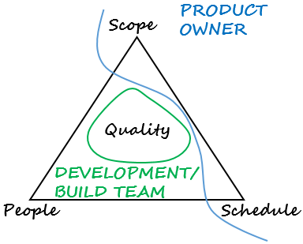
Development/Build Team
Primary focus:
Delivering a potentially shippable increment of “Done” functionality each Sprint
Responsibilities:
Commit on selected amount of features to be built in a sprint
Focuses on technical excellence
Presents each sprint achievements in a form of a demo
Continuously looks to improve their efficiency and effectiveness
Contributes and helps the PO with Backlog refinement
Notes:
The Development Team consists of professionals who do the work of delivering a potentially releasable Increment of “Done” product at the end of each Sprint. Only members of the Development Team create the Increment.
The Development Team consists of professionals who build an increment of product functionality every Sprint. Only members of the Development Team create the Increment. This increment must be potentially shippable, because the Product Owner might choose to immediately implement the functionality. This requires that the increment consist of thoroughly tested, well structured, and well-written code that has been built and that the functionality is documented, either in Help files or in user documentation. This is the definition of a “done” increment.
Other responsibilities are as follow:
Selects and commit on the amount of features to be built in a sprint
Focuses on technical excellence
Presents each sprint achievements in a form of a demo
Continuously looks to improve their efficiency and effectiveness (Teams are responsible to inspect and adapt their process in the Sprint Retrospective Meeting)
Contributes and helps the Product Owner with Backlog refinement
Source:
https://www.scrum.org/Portals/0/Documents/Scrum%20Guides/2013/Scrum-Guide.pdf#zoom=100

Slide 24
Attributes of a good Development/Build Team
Self-organized: autonomy to determine how and when to complete its work
Cross-functional: having all of the skills necessary to create a product Increment
No titles other than Developer: “Unus pro omnibus, omnes pro uno”
3 to 9 members: optimal size
Sitting together: maximizing value of collaboration
Long term members: being high performance team
Agile attitude: applying 5 values of Scrum. Inspect and adapt
Notes:
They are self-organizing. No one (not even the Scrum Master) tells the Development Team how to turn Product Backlog into Increments of potentially releasable functionality. The team has the autonomy to determine how and when to complete its work. As long as the team finishes its work by the deadline and under budget, it is entirely up to the team to determine how that happens. The team decides the amount of work it takes on. The Product Owner will expect the team to take on as many story points of work as possible, within reason. (The team would reference its established velocity for previous sprints to negotiate how many story points would be reasonable.) The value of this process of negotiation is twofold. It protects the development team from becoming swamped with an unrealistic workload. It also manages the expectations of the Product Owner, who, in turn, can do the same for customers.
Usually, teams are comprised of cross-functional members. Individual Development Team members may have specialized skills and areas of focus, including architecture, analysis, design, programming, testing, UI design, etc.
However, there should not be titles for Development Team members other than Developer, regardless of the work being performed by the person; there are no exceptions to this rule. Team members should be united and focused. They should be all for one and one for all. Also, Development Teams do not contain sub-teams dedicated to particular domains like testing or business analysis.
Optimal Development Team size is small enough to remain nimble and large enough to complete significant work. Fewer than three Development Team members decreases interaction and results in smaller productivity gains. Smaller Development Teams may encounter skill constraints during the Sprint, causing the Development Team to be unable to deliver a potentially releasable Increment. Having more than nine members requires too much coordination. Large Development Teams generate too much complexity for an empirical process to manage. The Product Owner and Scrum Master roles are not included in this count unless they are also executing the work of the Sprint Backlog.
It is recommended all team members be located in the same room, called the team room. The most efficient and effective method of conveying information to and within a development team is face-to-face conversation. (Agile Manifesto principle)
High performance teams have low fluctuations in staff and they have got to know each other well. They know each other’s strengths and weaknesses and have learnt to work together.
Agile attitude. Team members should apply those 5 values of Scrum: Commitment, Focus, Respect, Openness, Courage. Also team members should be able to Inspect and Adapt. For example: no matter how well you learned to dance on your last project, your next project will require new steps. Like learning a new dance, you will find, however, that learning the optimal interactions for a new project gets easier the more scrum experience you have. So, When the band is playing a waltz, it’s not the right time to tango. Inspect and adapt.
Source:
https://www.scrum.org/Portals/0/Documents/Scrum%20Guides/2013/Scrum-Guide.pdf#zoom=100
http://scrummethodology.com/the-scrum-team-role/
http://www.scrumalliance.org/community/articles/2011/july/dancing-with-pigs

Slide 25
Essential Scrum
Intro
Team
Product Owner
Build Team
Scrum Master
Ceremonies
Artifacts

Slide 26
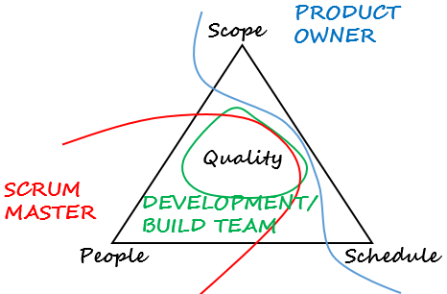
Scrum Master
Primary focus:
Servant leader for the team
Managing Scrum Processes
Responsibilities:
Enacting Scrum values and practices
Ensures the team is fully functional and productive
Shield the team and removes impediments
Facilitates Scrum ceremonies
Enable close cooperation across all roles and functions
Notes:
Much has already been written about the job of the ScrumMaster in removing impediments to the team’s progress (Schwaber and Beedle 2001, Schwaber 2004). Most ScrumMasters quickly grasp that part of their job. Where many falter — especially during the critical first 6 to 12 months of using Scrum—is in their relationships to their teams, which is why we will focus on that topic here.
Many who are new to the ScrumMaster role struggle with the apparent contradiction of the ScrumMaster as both a servant-leader to the team and also someone with no authority. The seeming contradiction disappears when we realize that although the ScrumMaster has no authority over Scrum team members, the ScrumMaster does have authority over the process. Although a ScrumMaster may not be able to say, “You’re fired,” a ScrumMaster can say, “I’ve decided we’re going to try two-week sprints for the next month.” (Ideally, the ScrumMaster tries to get team members to decide this on their own. But, if they do not, the ScrumMaster’s authority over the process allows for this decision.)
The ScrumMaster is there to help the team in its use of Scrum. Think of the help from a ScrumMaster as similar to a personal trainer who helps you stick with an exercise regimen and perform all exercises with the correct form. A good trainer will provide motivation while at the same time making sure you don’t cheat by skipping a hard exercise. The trainer’s authority, however, is limited. The trainer cannot make you do an exercise you don’t want to do. Instead, the trainer reminds you of your goals and how you’ve chosen to meet them. To the extent that the trainer does have authority, it has been granted by the client. ScrumMasters are much the same: They have authority, but that authority is granted to them by the team.
A ScrumMaster can say to a team, “Look, we’re supposed to deliver potentially shippable software at the end of each sprint. We didn’t do that this time. What can we do to make sure we do better the next sprint?” This is the ScrumMaster exerting authority over the process; something has gone wrong with the process if the team has failed to deliver something potentially shippable. But because the ScrumMaster’s authority does not extend beyond the process, the same ScrumMaster should not say, “Because we failed to deliver something potentially shippable the last sprint, I want Tod to review all code before it gets checked in.” Having Tod review the code might be a good idea, but the decision is not the ScrumMaster’s to make. Doing so goes beyond authority over the process and enters into how the team works.
With authority limited to ensuring the team follows the process, the ScrumMaster’s role can be more difficult than that of a typical project manager. Project managers often have the fallback position of “do it because I say so.” The times when a ScrumMaster can say that are limited and restricted to ensuring that Scrum is being followed.
Source:
1. Succeeding with Agile: Software Development Using Scrum by Mike Cohn
2. The separation of power in SCRUM: http://agiletips.blogspot.ro/2012_04_01_archive.html

Slide 27
Attributes of a good Scrum Master
Servant Leader: facilitate the growth of people and organisation
Responsible: responsibility that comes without power
Humble: “look what I helped accomplish” rather than “look what I accomplished”
Collaborative: establishing collaboration as the team norm
Committed: remaining in the role for the full duration of the project
Influential: convincing others, both on the team and outside it
Knowledgeable: knowing enough about programming and marketing to be effective in leading the team
Notes:
Many organizations choose their first Scrum Masters by looking for management or leadership experience. This is a common pitfall. As they become more experienced with Agile, organizations eventually realize there are many more factors to consider in selecting Scrum Masters.
Servant Leader
Former AT&T executive Robert K. Greenleaf coined the term servant leadership in 1970. Although it has taken four decades for his philosophies to have a real influence on mainstream management thinking, a number of companies riding high in the Fortune 100 Best Companies to Work For have adopted his principles to great effect by building cultures in which employees come first and leaders exist to facilitate their growth collectively and individually. Servant leadership is often misunderstood, possibly this is because people find it confusing to have the words servant and leadership together. To be a leader of people, executives often mistakenly believe, one always has to be the driving force that subordinates follow. Indeed, research tells us that to be an effective leader individuals must have a certain motivation to lead.
However, servant leadership requires a different approach and in addition to the motivation to lead, there must be the need to serve both people and organisation.
The term "servant leader" has emerged in the Agile community and replaced the typical command-and-control project manager. A servant leader observes how the members of the team operate and interact with each other. He or she asks probing questions and acts as a "flashlight," shining light on areas that individual team members may not notice. It is critical for the servant leader to treat everyone with respect and dignity, even when tensions are high. Conflict among team members is normal and actually a good thing. A servant leader understands this and embraces healthy debate. Self-organizing teams do not happen automatically. They emerge under the proper guidance and advice of a servant leader.
No one would ever admit to not being motivated. The servant leader pays attention to the aspirations and goals of the team members and aligns these goals with project needs wherever possible. People perform best when they are doing something they are passionate about. A good servant leader also shelters the team from outside distractions. In Scrum, a team commits to completing a set of features. Anything that distracts from this is a risk. By being there for the team, the servant leader provides them with the environment and support needed for success.
Responsible
A good ScrumMaster is able and willing to assume responsibility. That is not to say that ScrumMasters are responsible for the success of the project; that is shared by the team as a whole. However, the ScrumMaster is responsible for maximizing the throughput of the team and for assisting team members in adopting and using Scrum. As noted earlier, the ScrumMaster takes on this responsibility without assuming any of the authority that might be useful in achieving it.
Think of the ScrumMaster as similar to an orchestra conductor. Both must provide real-time guidance and leadership to a talented collection of individuals
who come together to create something that no one of them could create alone. Boston Pops conductor Keith Lockhart has said of his role, “People assume that when you become a conductor you’re into some sort of a Napoleonic thing— that you want to stand on that big box and wield your power. I’m not a power junkie, I’m a responsibility junkie” (Mangurian 2006, 30). In an identical manner, a good ScrumMaster thrives on responsibility— that special type of responsibility that comes without power.
Humble
A good ScrumMaster is not in it for her ego. She may take pride (often immense pride) in her achievements, but the feeling will be “look what I helped accomplish” rather than the more self-centered “look what I accomplished.” A humble ScrumMaster is one who realizes the job does not come with a company car or parking spot near the building entrance. Rather than putting her own needs first, a humble ScrumMaster is willing to do whatever is necessary to help the team achieve its goal. Humble ScrumMasters recognize the value in all team members and by example lead others to the same opinion.
Collaborative
A good ScrumMaster works to ensure a collaborative culture exists within the team. The ScrumMaster needs to make sure team members feel able to raise issues for open discussion and that they feel supported in doing so. The right ScrumMaster helps create a collaborative atmosphere for the team through words and actions. When disputes arise, collaborative ScrumMasters encourage teams to think in terms of solutions that benefit all involved rather than in terms of winners and losers. A good ScrumMaster models this type of behavior by working with other ScrumMasters in the organization. However, beyond modeling a collaborative attitude, a good ScrumMaster establishes collaboration as the team norm and will call out inappropriate behavior (if the other team members don’t do it themselves).
Committed
Although being a ScrumMaster is not always a full-time job, it does require someone who is fully committed to doing it. The ScrumMaster must feel the same
high level of commitment to the project and the goals of the current sprint as the team members do. As part of that commitment, a good ScrumMaster does not end very many days with impediments left unaddressed. There will, of course, be times when this is inevitable, as not all impediments can be removed in a day. For example, convincing a manager to dedicate a full-time resource to the team may take a series of discussions over several days. On the whole, however, if a team finds that impediments are often not cleared quickly, team members should remind their ScrumMaster about the importance of being committed to the team.
One way a ScrumMaster can demonstrate commitment is by remaining in that role for the full duration of the project. It is disruptive for a team to change
ScrumMasters mid-project.
Influential
A successful ScrumMaster influences others, both on the team and outside it. Initially, team members might need to be persuaded to give Scrum a fair trial or to behave more collaboratively; later, a ScrumMaster may need to convince a team to try a new technical practice, such as test-driven development or pair programming. A ScrumMaster should know how to exert influence without resorting to a dictatorial “because I say so” style.
Most ScrumMasters will also be called upon to influence those outside the team. For example, a ScrumMaster might need to convince a traditional team to
provide a partial implementation to the Scrum team. Or, a ScrumMaster might need to prevail upon a QA director to dedicate full-time testers to the project.
Although all ScrumMasters should know how to use their personal influence, the ideal one will come with a degree of corporate political skill. The term “corporate politics” is often used pejoratively; however, a ScrumMaster who knows who makes decisions in the organization, how those decisions are made, which coalitions exist, and so on can be an asset to a team.
Knowledgeable
Beyond having a solid understanding of and experience with Scrum, the best ScrumMasters also have the technical, market, or other specialized knowledge to
help the team pursue its goal. LaFasto and Larson have studied successful teams and their leaders and have concluded that “an intimate and detailed knowledge of how something works increases the chance of the leader helping the team surface the more subtle technical issues that must be addressed” (2001, 133). Although ScrumMasters do not necessarily need to be marketing gurus or programming experts, they should know enough about both to be effective in leading the team.
Tech leads as ScrumMasters
That we’d like ScrumMasters to have solid technical knowledge does not mean, however, that we simply anoint each team’s tech lead as its ScrumMaster. In fact, because Scrum teams are self-organizing, there should not be a companydesignated role such as “tech lead.” However, when adopting Scrum it can be very tempting to take the former tech leads and search for equivalent roles where they can exert similar influence on the team and the product. Often this leads to designating tech leads as ScrumMasters. Although some tech leads make great ScrumMasters, never select someone as a ScrumMaster solely because of this, or any other,past role.
Source:
Succeeding with Agile – Mike Cohn
http://www.iedp.com/Blog/six_key_servant_leadership_attributes
http://www.scrumalliance.org/community/articles/2013/november/the-agile-manifesto-principles-what-do-they-mean
Additional reading:
http://agile.dzone.com/articles/scrum-master-servant
http://hurricanefour.com/scrum-master-the-servant-leader
http://www.aboutleaders.com/lbso-lead-by-serving-others-a-new-acronym-for-leadership/
http://www.agileforall.com/2009/09/new-to-agile-what-does-the-scrummaster-do-anyway/

Slide 28
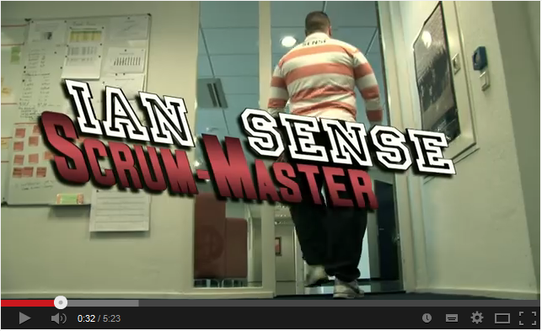
The Power of Scrum
https://www.youtube.com/watch?v=P6v-I9VvTq4
Notes:
Movie about Ian Sense, Scrum Master: https://www.youtube.com/watch?v=P6v-I9VvTq4

Slide 29
Essential Scrum
Intro
Team
Ceremonies
Sprint Planning
Backlog Refinement
Daily Scrum
Sprint Review
Sprint Retrospective
Artifacts

Slide 30
Scrum in a Nutshell
30
Notes:
Scrum hangs all of its practices on an iterative, incremental process skeleton. Scrum’s skeleton is shown on the slide. The lower circle represents
an iteration of development activities that occur one after another. The output of each iteration is an increment of product. The upper circle
represents the daily inspection that occurs during the iteration, in which the individual team members meet to inspect each others’ activities and
make appropriate adaptations. Driving the iteration is a list of requirements. This cycle repeats until the project is no longer funded.
The skeleton operates this way: At the start of an iteration, the team reviews what it must do. It then selects what it believes it can turn in to an
increment of potentially shippable functionality by the end of the iteration. The team is then left alone to make its best effort for the rest of the
iteration. At the end of the iteration, the team presents the increment of functionality it built so that the stakeholders can inspect the functionality and
timely adaptations to the project can be made.
The heart of Scrum lies in the iteration. The team takes a look at the requirements, considers the available technology, and evaluates its own skills
and capabilities. It then collectively determines how to build the functionality, modifying its approach daily as it encounters new complexities,
difficulties, and surprises. The team figures out what needs to be done and selects the best way to do it. This creative process is the heart of the
Scrum’s productivity.
Ken Schwaber – Agile Project Management with Scrum

Slide 31
Essential Scrum
Intro
Team
Ceremonies
Sprint Planning
Backlog Refinement
Daily Scrum
Sprint Review
Sprint Retrospective
Artifacts

Slide 32
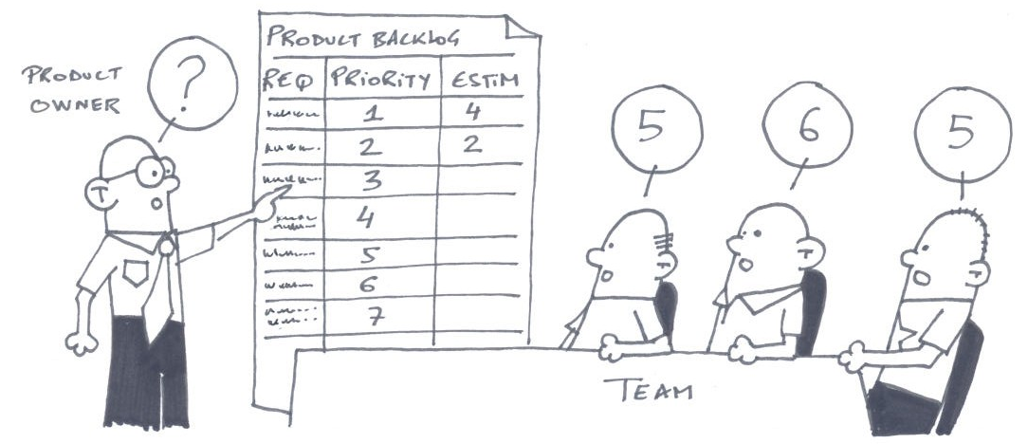
Sprint Planning - Why
A collaborative effort so that the Agile Team Members:
Reach the same transparency over the top items ordered in the Product Backlog
Define the vision for the Sprint - by crafting a common Goal that would be respected over Sprint's duration
Establish and unify build team's plan of work (plan the work that will be performed in the Sprint)
Define what will be delivered and how will the work be done
Time-boxed: 4h per 2 weeks sprint
(Usually shorter/longer for shorter/longer sprints)
Notes:
Sprint Planning meeting is to give the team enough information to be able to work in undisturbed peace for 2 weeks (a few weeks) and give the product owner enough confidence to let them do so.
Picture from: http://manu40k.free.fr/articleScrum.pdf

Slide 33
Sprint Planning What can be done in this Sprint
Practices
Product Owner - discusses the objective for the Sprint and the Product Backlog items
Scrum Master - Facilitates the event
The Build Team - works to forecast the functionality that will be developed during the Sprint
Input for this meeting: Product Backlog; last product Increment, past performance of the team (velocity); capacity of the Build Team for the Sprint
Attendants
Product Owner
The Build Team
Scrum Master
Outcome
What can be delivered in the Increment resulting from the upcoming Sprint?
Build Team - Forecast of the items delivered
Agile Team – crafts the Sprint Goal
Common pitfalls
Lack of PO involvement
PO not prepared - Backlog not prioritized, Product Backlog items (Epics, Stories, bugs) not READY
Notes:
Normally the product owner starts the meeting by summarizing his goal for the sprint and the most important stories. Next, the team goes through and time-estimates each story, starting with the most important one. As they do this, they will come up with important scope questions – “does this ‘delete user’ story include going through each pending transaction for that user and canceling it?’” In some cases the answers will be surprising to the team, prompting them to change their estimates. In some cases the time estimate for a story won’t be what the product owner expected. This may prompt him to change the importance of the story. Or change the scope of the story, which in turn will cause the team to re-estimate, etc, etc. This type of direct collaboration is fundamental to Scrum and, in fact, all agile software development.
Scrum guide:
“The Development Team works to forecast the functionality that will be developed during the Sprint. The Product Owner discusses the objective that the Sprint should achieve and the Product Backlog items that, if completed in the Sprint, would achieve the Sprint Goal. The entire Scrum Team collaborates on understanding the work of the Sprint.
The input to this meeting is the Product Backlog, the latest product Increment, projected capacity of the Development Team during the Sprint, and past performance of the Development Team. The number of items selected from the Product Backlog for the Sprint is solely up to the Development Team. Only the Development Team can assess what it can accomplish over the upcoming Sprint.
After the Development Team forecasts the Product Backlog items it will deliver in the Sprint, the Scrum Team crafts a Sprint Goal. The Sprint Goal is an objective that will be met within the Sprint through the implementation of the Product Backlog, and it provides guidance to the Development Team on why it is building the Increment.”
Other participants that may join the sprint planning: Key business users that are experts on areas that will be part of the product
High level description of Velocity/Estimation techniques: Move a Pile of Rocks from here to the front of the Endava Office. Relative or absolute(time/kg)
It is very important for the PO to attend the SP. Sometimes PO are reluctant to spend hours with the team during SP. Proxy PO – fully empowered to take decisions.
Each story contains 3 variables highly dependent on each other: Scope, Estimate, Importance. The first 2 are set by the PO, estimates are set by the team. During the sprint planning these 3 variables are fine-tuned continuously though dialog between the team and the PO.
http://www.mountaingoatsoftware.com/agile/scrum/sprint-planning-meeting/
During the sprint planning meeting, the product owner describes the highest priority features to the team. The team asks enough questions that they can turn a high-level user story of the product backlog into the more detailed tasks of the sprint backlog.
The product owner doesn't have to describe every item being tracked on the product backlog. A good guideline is for the product owner to come to the sprint planning meeting prepared to talk about two sprint's worth of product backlog items. To make an example really simple, suppose a team always finishes five product backlog items. Their product owner should enter the meeting prepared to talk about the top 10 priorities.
There are two defined artifacts that result from a sprint planning meeting: A sprint goal; A sprint backlog
An important point to reiterate here is that it's the team that selects how much work they can do in the coming sprint. The product owner does not get to say, "We have four sprints left so you need to do one-fourth of everything I need." We can hope the team does that much (or more), but it's up to the team to determine how much they can do in the sprint.

Slide 34
Sprint Planning How will the chosen work get done?
Practices
Build Team - decides how it will build this functionality into a “Done” product
Task breakdown – units of one day or less
Enough work planned to forecast if can be done in the Sprint
May renegotiate the scope with the PO
Product Owner - Clarifies the selected Product Backlog items and makes tradeoffs
Attendants
Build Team
Scrum Master
Product Owner(optional)
Outcome
How will the work needed to be delivered in the Increment be achieved?
Sprint Backlog:
Product Backlog items selected and
Plan for delivering them as a self organizing team
Common pitfalls
1st Item takes the longest to discuss
Not enough time for items to breakdown and estimate
Notes:
Scrum guide:
Having set the Sprint Goal and selected the Product Backlog items for the Sprint, the Development Team decides how it will build this functionality into a “Done” product Increment during the Sprint. The Product Backlog items selected for this Sprint plus the plan for delivering them is called the Sprint Backlog.
The Development Team usually starts by designing the system and the work needed to convert the Product Backlog into a working product Increment. Work may be of varying size, or estimated effort. However, enough work is planned during Sprint Planning for the Development Team to forecast what it believes it can do in the upcoming Sprint. Work planned for the first days of the Sprint by the Development Team is decomposed by the end of this meeting, often to units of one day or less. The Development Team self-organizes to undertake the work in the Sprint Backlog, both during Sprint Planning and as needed throughout the Sprint.
The Product Owner can help to clarify the selected Product Backlog items and make trade-offs. If the Development Team determines it has too much or too little work, it may renegotiate the selected Product Backlog items with the Product Owner. The Development Team may also invite other people to attend in order to provide technical or domain advice.
By the end of the Sprint Planning, the Development Team should be able to explain to the Product Owner and Scrum Master how it intends to work as a self-organizing team to accomplish the Sprint Goal and create the anticipated Increment.

Slide 35

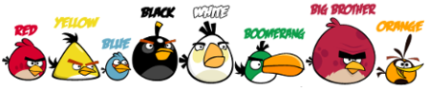
Sprint Goal
WHY
to help the team to keep focus on what adds business value to the product at the end of the Sprint
to ensure that everyone moves in the same direction during the Sprint
WHAT
short, one- or two-sentence, description of what the team plans to achieve during the Sprint
A Sprint Goal summarizes the desired outcome of an iteration
HOW
written collaboratively by the team and the PO
the Sprint Goal is an objective that will be met within the Sprint through the implementation of the Sprint Backlog, and it provides guidance to the team on why it is building the Increment
TRANSPARENCY
it allows flexibility during the Sprint; not all User Stories must be completed to achieve the Sprint Goal
Notes:
In Angry Birds game the goal in each level is to get rid of the pigs. The satisfied pigs are usually blocked by wood, glass, stone or another material arranged into creative structures. As a player of the game, you will need to use the angry birds to get rid of both the obstacles and pigs.
So the objective is to pop the pigs, this means that sometimes you can achieve the goal without destroying all the materials that are protecting the pigs.
Same in Scrum, every sprint has a goal, that can be achieved without completing all the user stories / items from the backlog.

Slide 36
Essential Scrum
Intro
Team
Ceremonies
Sprint Planning
Backlog Refinement
Daily Scrum
Sprint Review
Sprint Retrospective
Artifacts

Slide 37

Backlog Refinement - Why
The process of adding detail, estimates, and prioritize items in the Product Backlog
To help the Product Owner get the top of the Product Backlog ready for the next Sprint Planning meeting
To help Product Owner to have a better estimation of the work to be done. Help him to have a Release Plan.
Have enough clarity for the next pieces of work so that we can plan the next sprint and eliminate waste
The goal is to create Product Backlog items that meet the Definition of Ready
Create stories that are Independent, Negotiable, Valuable, Estimable, Small, Testable
Refinement usually consumes no more than 10%
of the capacity of the Build Team
Notes:
Iterative, collaborative, ongoing process in which the PO and Development Team review and revise higher ordered Product Backlog items

Slide 38
Backlog Refinement - How
Practices
Responsibility of the entire team to establish the DoR; the point when a US makes sense
US: 3C's: card, collaboration, confirmation
The high-priority stories are prepared for the future Sprint Planning meeting, being split, additional details added and refined to meet the Definition of Ready.
Build Team is responsible for estimating effort
Reorder backlog items
Clarification of requirements
Attendants
Product Owner Build Team
Scrum Master
Outcome
Backlog prepared for the future Sprint Planning meeting
Advices
Consumes up to 10% of the capacity of the Build Team
Happens once or twice a week to review the backlog
A well formed Product Backlog item is no bigger than one quarter of a Sprint
Notes:
Product Backlog refinement is the act of adding detail, estimates, and order to items in the Product Backlog. This is an ongoing process in which the Product Owner and the Development Team collaborate on the details of Product Backlog items. During Product Backlog refinement, items are reviewed and revised. The Scrum Team decides how and when refinement is done.
Refinement usually consumes no more than 10% of the capacity of the Development Team.
However, Product Backlog items can be updated at any time by the Product Owner or at the Product Owner’s discretion.
Higher ordered Product Backlog items are usually clearer and more detailed than lower ordered ones. More precise estimates are made based on the greater clarity and increased detail; the lower the order, the less detail. Product Backlog items that will occupy the Development Team for the upcoming Sprint are refined so that any one item can reasonably be “Done” within the Sprint time-box. Product Backlog items that can be “Done” by the Development Team within one Sprint are deemed “Ready” for selection in a Sprint Planning. Product Backlog items usually acquire this degree of transparency through the above described refining activities.
The Development Team is responsible for all estimates. The Product Owner may influence the Development Team by helping it understand and select trade-offs, but the people who will perform the work make the final estimate.
Looking ahead meetings where:
Development Team is responsible for all estimates
Development Team decides how and when refinement is done

Slide 39
Essential Scrum
Intro
Team
Ceremonies
Sprint Planning
Backlog Refinement
Daily Scrum
Sprint Review
Sprint Retrospective
Artifacts

Slide 40
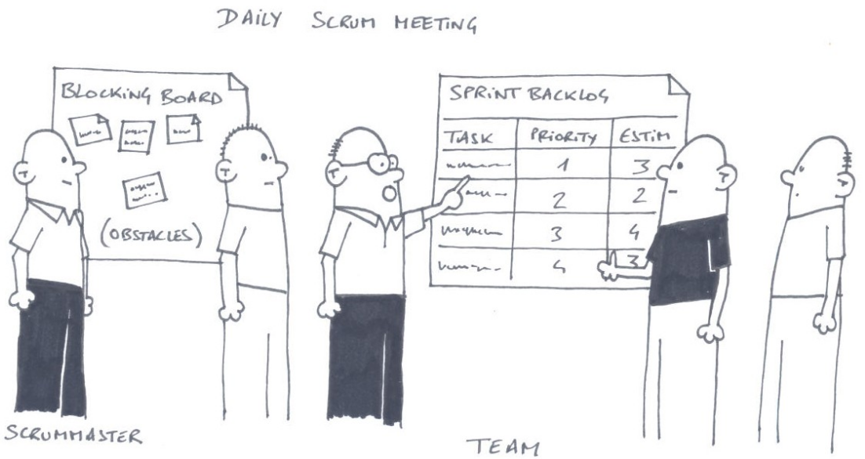
Daily Scrum - Why
An opportunity when build team meets to discuss their progress against the plan
To obtain understanding of what work has been done and what work remains
To adjust the plan and the work in order to meet the Sprint Goal and complete Sprint Backlog items
Identify impediments to development for removal
Improve communications
Eliminate other meetings
Highlight and promote quick decision-making
Improve Build Team’s level of knowledge
Time-boxed: 15 minutes
Notes:
Other benefits:
Increased focus
Better alignment
Better collaboration
Reduce time to add business value
Picture from: http://manu40k.free.fr/articleScrum.pdf

Slide 41
Daily Scrum - How
Practices
Held at the same place same hour; usually in the morning
Everyone can participate but only the Product Owner and Build Team are allowed to speak
Sometimes another client facing meeting is needed for the team to update the PO of the progress - nearshore agile optimization technique
Pass the Token - each member of the build team shares the update of his work by answering 3 questions:
What did I do yesterday that helped build team meet the Sprint Goal?
What will I do today to help build team meet the Sprint Goal?
Do I see any impediments that prevent me or anyone in the build team meet the Sprint Goal?
Walk the Board - item approach; team members provide updates on the items from board
Attendants
Build Team Product Owner (optional)
Scrum Master (makes sure the Daily Scrum takes place)
Outcome
Revised plan for the day/sprint
Revised impediments list
Common pitfalls
This meeting transforms in a solve all issues meeting
The meeting transforms in a report meeting when someone collects information about who and what is behind schedule
Obstacles raised in the stand-up are not removed or otherwise addressed in a timely fashion
Notes:
The goals of the daily stand-up are GIFTS. It helps:
To help start the day well - should give energy, not take it. Energy comes from instilling a sense of purpose and urgency; a clear sense of the purpose and a clear understanding what needs to be done to achieve it. It's important to distinguish this from "false urgency", where people are geared up for activity but are without shared direction.
To support improvement - We can't fix problems we don't know about so a large part of stand-ups is about exposing problems to allow us to improve. Improvement is not just about problem solving though. Sharing better techniques and ideas is also important.
To reinforce focus on the right things - It is too easy to confuse effort with work. The stand-up should encourage a focus on moving work through the system in order to achieve our objectives, not encourage pointless activity.
To reinforce the sense of TEAM - More so than artificial “team-building” exercises, effective teams are built by regularly communicating, working, and helping each other. This is also strongly tied with team members helping each other with shared obstacles. And an effective team is autonomous, otherwise known as self-managing.
To communicate what is going on - Status is about answering a couple questions:
How is the work progressing?
Is there anything else interesting that the team should know?
Where and when: Meet Where the Work Happens
“Do the meeting in the gemba, not a conference room.”-- Marc Graban, "Video of a Daily Huddle at Everett Clinic“
Fifteen Minutes or Less
Most people will wander mentally when they are in long meetings. A long, droning meeting is a horrible, energy-draining way to start the day. A specific number helps remind us when to consider adjustment to reduce the time of the meeting.
Pass the Token
With simple, predictable ordering mechanisms (e.g., Round Robin), it is very easy for participants to ignore other speakers until it is closer to their turn. There may be a tendency to think of other things rather than pay attention to what others are saying.
Walk the Board, that is, structure the stand-up by walking through each work item that is displayed on Agile task board. With this board in place, the stand-up moves through each work item from end of process to start of process (e.g., right-to-left) and from highest-to-lowest priority (e.g., top-to-bottom). You may even explicitly indicate on the board what sequence should be used.
Output: Improvement Board: Also Known As: Blockage Board, Impediment Board, Kaizen Newspaper

Slide 42
Essential Scrum
Intro
Team
Ceremonies
Sprint Planning
Backlog Refinement
Daily Scrum
Sprint Review
Sprint Retrospective
Artifacts

Slide 43
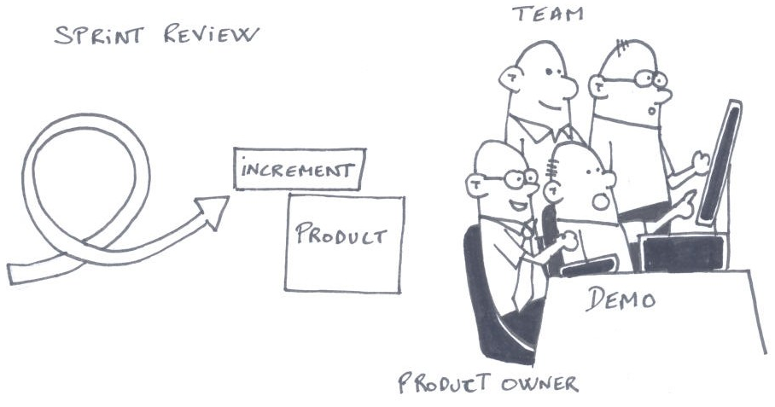
Sprint Review - Why
A close collaboration between the Agile Team and stakeholders of what has been done in the sprint
See how the product was improved by the addition of new features and functionalities
Necessary to optimize product value; all participants collaborate in identifying items from PB that bring the most value
A planning meeting for the rest of the backlog when all participants collaborate to adapt the PB and improve the product
A meeting when we learn from what it has been done / experienced during the sprint
Outward focused. How can we improve our product ?
Elicit feedback and foster collaboration
Time-boxed: 2h per 2 weeks sprint
(Usually shorter/longer for shorter/longer sprints)
Notes:
Picture from: http://manu40k.free.fr/articleScrum.pdf
Source: http://www.mountaingoatsoftware.com/agile/scrum/sprint-review-meeting
In Scrum, each sprint is required to deliver a potentially shippable product increment. This means that at the end of each sprint, the team has produced a coded, tested and usable piece of software.
So at the end of each sprint, a sprint review meeting is held. During this meeting, the Scrum team shows what they accomplished during the sprint. Typically this takes the form of a demo of the new features.
The sprint review meeting is intentionally kept very informal, typically with rules forbidding the use of PowerPoint slides and allowing no more than two hours of preparation time for the meeting. A sprint review meeting should not become a distraction or significant detour for the team; rather, it should be a natural result of the sprint.
Participants in the sprint review typically include the product owner, the Scrum team, the ScrumMaster, management, customers and developers from other projects.
During the sprint review, the project is assessed against the sprint goal determined during the sprint planning meeting. Ideally, the team has completed each product backlog item brought into the sprint, but it's more important that they achieve the overall goal of the sprint.
It will definitely not contain PowerPoint slides
Agile SCRUM relies heavy on customer feedback, usually he needs to see a baseline (i.e. the wrong product) to identify what he actually wants or needs.
Sprint Review meeting must encourage the client to provide feedback on current product value and to adapt and decide on the next improvement that will add the most value.
The Team will highlight the challenges and obstacles they encountered while delivering the current product version.
Client and/or Product Owner will decide if the user stories presented are “Done” or not.
A preliminary Product Backlog prioritization takes place during Sprint Review
A meeting when we learn from what it has been done / experienced during the sprint LEARN and Respond part of an increment's inspect-and-adapt cycle.

Slide 44
Sprint Review - How
Practices
Takes place in the last day of the Sprint
Product Owner explains what has been done by the build team and what obstacles they encountered
Team presents what was accomplished during the Sprint, the working product
Stakeholders, Product Owner, Build Team look through the PB and identify items that could be implemented by the team next sprint; they refine the PB
A User Story is considered done if the Product Owner and business users confirm that the acceptance criteria are met
Feedback collected during the meeting is logged to be validated & prioritized by the Product Owner
Attendants
Product Owner End users Customers BA’s Stakeholders Build Team
Project Managers Project Sponsors
Outcome
User Stories that have been accepted (Done) by the Product Owner or business users
Feedback regarding the value added by the new functionalities
Identify the next functionality that will add the most value to the product
Common pitfalls
This event could became a demo meeting and not generate any feedback
Loosing the ideal moment of adding additional value
Story demo becomes a full functional testing review
Notes:
Source: http://www.dummies.com/how-to/content/the-agile-management-sprint-review.html
The sprint review usually takes place later in the day on the last day of the sprint, often a Friday. One of the rules of scrum is to spend no more than one hour in a sprint review meeting for every week of the sprint.
Logistics: Takes place in the last day of the sprint (phone conference and Webex session)
Guidelines for your sprint review meeting:
Pre-demo story validation are highly recommended if possible.
No PowerPoint slides! Refer to the sprint backlog if you need to display a list of completed user stories.
The entire scrum team should participate in the meeting.
Anyone who is interested in the meeting may attend. The project stakeholders, the summer interns, and the CEO could all theoretically be in a sprint review.
The product owner introduces the release goal, the sprint goal, and the new capabilities included.
The development team demonstrates what it completed during the sprint. Typically, the development team showcases new features or architecture. Incomplete developed or tested user stories will not be presented (99,9% of an user story done is considered not done)
The demonstration should be on equipment as close as possible to the planned production environment. For example, if you are creating a mobile application, present the features on a smartphone — perhaps hooked up to a monitor — rather than a laptop.
The stakeholders can ask questions and provide feedback on the demonstrated product.
No non-disclosed rigged functionality, such as hard-coded values and other programming shortcuts that make the application look more mature than it currently is.
The product owner can lead a discussion about what is coming next based on the features just presented and new items that have been added to the product backlog during the current sprint.
Last part of the Sprint Review Meeting will be used to:
Establish the added value of the User Stories delivered in the current Sprint, how the product has been improved
User stories prioritization opportunity taking into account of what has been delivered in the current Sprint:
Which user story from Product Backlog will add the most value to the product based on existing functionalities
Based on feedback collected Product Owner might add/remove/update user stories from Product Backlog
Improvement opportunity from a technical and business point of view :
Which technical pitfall can be avoided in the next sprint
Identify the possible the impediments
Highlight the blockers encountered in the current sprint
Demo Preparation:
Select the environment where the demo will be held (good practice indicates a persistent environment, like pre-production)
Prepare Demo data
Prepare a script workflow
Decide who will do the Demo, before the Demo!
DO A Dry Run (Rehearsal) - The team prepares for the review session, decide on how the work done will be presented: business workflow, individual user stories, functional workflow, etc.
Manage the expectations
Estimate the time required to go through all the user stories; usually for a 2 weeks sprint the sprint review will take 2 hours! Allocate time for outstanding defects walkthrough.
Incomplete developed or tested user stories will not be presented (99,9% of an user story done is considered not done).
Source: http://www.dummies.com/how-to/content/the-agile-management-sprint-review.html
Preparing for an agile sprint review
Logistics:
Scenery
Book the rooms, check the projector, screen sharing tools etc…
Be there 15 minutes (or more) earlier to prepare
Preparation for an agile sprint review meeting should not take more than a few minutes at most. The sprint review focuses on demonstrating what the development team has done. Knowing the completed user stories and being ready to demonstrate those stories' functionality prepares you to confidently start the sprint review meeting.
Preparing for the sprint review meeting involves the product owner and the development team. The product owner needs to know which user stories the development team completed during the sprint. The development team needs to be ready to demonstrate completed, shippable functionality.
For the development team to demonstrate the product in the sprint review, it must be complete according to the definition of done:
Developed
Tested
Integrated
Documented
As user stories are completed throughout the sprint, the product owner and development team should check that the product meets these standards. This continuous validation throughout the sprint reduces end-of-sprint risks and helps the scrum team spend as little time as possible preparing for the sprint review.

Slide 45
Essential Scrum
Intro
Team
Ceremonies
Sprint Planning
Backlog Refinement
Daily Scrum
Sprint Review
Sprint Retrospective
Artifacts

Slide 46
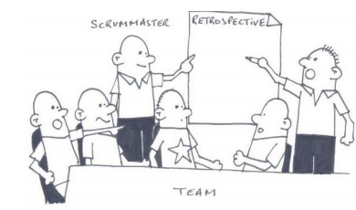
Sprint Retrospective - Why
Time-boxed: 1.5h per 2 weeks sprint
(Usually shorter/longer for shorter/longer sprints)
Helps teams – even great ones – to keep improving
Enable whole-team learning, act as catalyst for change, and generate action
Focus on inspecting and adapting the most valuable asset in a software organization, the team itself
Opportunity to change behaviour and team culture
Safe place for team members to share constructively feedback
Internal retrospective (an adjustment for near shore teams) benefits:
Face-To-Face contact
A better communication - using some visual materials Interpreting the body languages
Going faster through Tuckman's stages of group
Notes:
Picture from: http://manu40k.free.fr/articleScrum.pdf
http://www.mountaingoatsoftware.com/agile/scrum/sprint-retrospective/
Book: Agile Retrospectives: Making Good Teams Great [Esther Derby, Diana Larsen, Ken Schwaber]

Slide 47
Sprint Retrospective - How
Practices
The last thing done in a Sprint
1,5 hour time-boxed meeting for a 2 weeks Sprint
Pluses and deltas
Start-doing; Stop-doing; Continue-doing
Should start with the review actions from the previous retrospective
Attendants
Build Team
Scrum Master
Product Owner
Outcome
A plan for improvements to be enacted during the next Sprint
It’s a time for team to learn:
How to improve
How to work more efficiently
How to deliver at a higher velocity and with superior quality
Update the definition of done
Common pitfalls
Like Groundhog Day retro
Just crying retro
Happy playing games retro
Post-mortem retro
Notes:
Angel Medinilla - Agile Kaizen - I/II on Vimeo:
http://vimeo.com/66299864
http://vimeo.com/66505320
Like Groundhog Day retro
Same retrospective happened over and over again
People complained about the same stuff over and over
Just crying retro
Everything is bad
Managers don’t understand us
The company is against us
It is impossible to be agile in this environment
Happy playing games retro
Retrospectives like playground
Let’s do a new game with balls and balloons
Let’s hug each other
Post-mortem retro
Occur after the project is done (or even dead)
Often generate nice reports that are placed on a shelf and ignored
Sometimes turn into blame and shame events.

Slide 48
Essential Scrum
Intro
Team
Ceremonies
Artifacts
Product Backlog
Sprint Backlog
Retrospective Notes

Slide 49
Scrum in a Nutshell
49
Notes:
Scrum hangs all of its practices on an iterative, incremental process skeleton. Scrum’s skeleton is shown on the slide. The lower circle represents
an iteration of development activities that occur one after another. The output of each iteration is an increment of product. The upper circle
represents the daily inspection that occurs during the iteration, in which the individual team members meet to inspect each others’ activities and
make appropriate adaptations. Driving the iteration is a list of requirements. This cycle repeats until the project is no longer funded.
The skeleton operates this way: At the start of an iteration, the team reviews what it must do. It then selects what it believes it can turn in to an
increment of potentially shippable functionality by the end of the iteration. The team is then left alone to make its best effort for the rest of the
iteration. At the end of the iteration, the team presents the increment of functionality it built so that the stakeholders can inspect the functionality and
timely adaptations to the project can be made.
The heart of Scrum lies in the iteration. The team takes a look at the requirements, considers the available technology, and evaluates its own skills
and capabilities. It then collectively determines how to build the functionality, modifying its approach daily as it encounters new complexities,
difficulties, and surprises. The team figures out what needs to be done and selects the best way to do it. This creative process is the heart of the
Scrum’s productivity.
Ken Schwaber – Agile Project Management with Scrum

Slide 50
Essential Scrum
Intro
Team
Ceremonies
Artifacts
Product Backlog
Sprint Backlog
Retrospective Notes

Slide 51
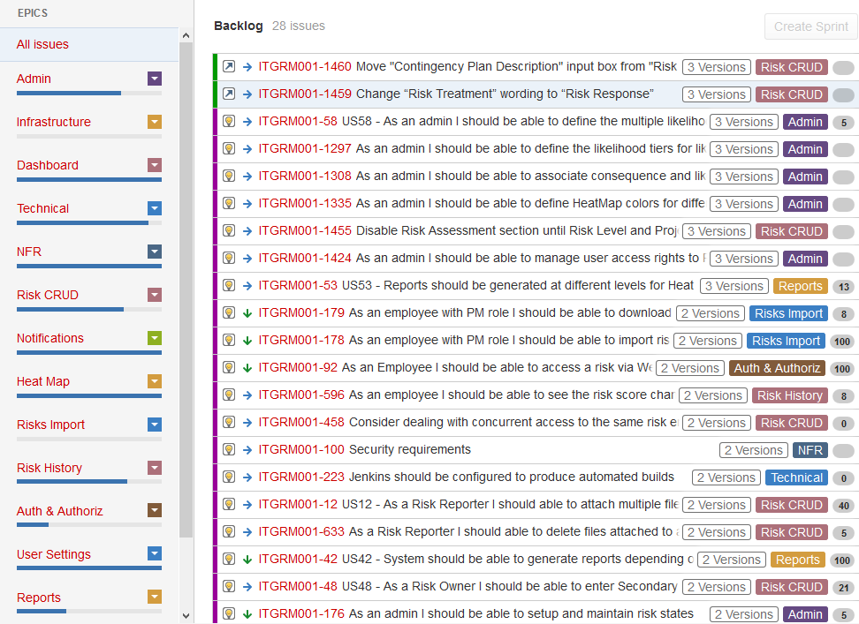
Product Backlog
WHY
the only source of information for product scope and shape
identifies the business critical features (80/20 rule)
provides transparency between two worlds, client and contractor/partner
guiding beacon for business and development voyage
helps the Build Team to understand the business (product) goals and reasoning to achieve a valuable outcome
WHAT
a high level ordered list of customer requirements for the project that is owned by the Product Owner
Notes:
In the simplest definition the Scrum Product Backlog is simply a list of all things that needs to be done within the project. It replaces the traditional requirements specification artifacts. These items can have a technical nature or can be user-centric e.g. in the form of user stories. The owner of the Scrum Product Backlog is the Scrum Product Owner. The Scrum Master, the Scrum Team and other Stakeholders contribute it to have a broad and complete To-Do list. Working with a Scrum Product Backlog does not mean that the Scrum Team is not allowed to create and use other artifacts. Examples for additional artifacts could be a summary of the various user roles, workflow descriptions, user interface guidelines, storyboards, or user interface prototypes. However, these artifacts do not replace the Scrum Product Backlog but complement and detail its content. The Scrum Product Owner uses the Scrum Product Backlog during the Sprint Planning Meeting to describe the top entries to the team. The Scrum Team then determines which items they can complete during the coming sprint. Each Scrum Product Backlog has certain properties that differentiate it from a simple to-do list:
an entry in the Scrum Product Backlog always add value for the customer
the entries in the Scrum Product Backlog are prioritized and ordered accordingly
the level of detail depends on the position of the entry within the Scrum Product Backlog
all entries are estimated
the Scrum Product Backlog is a living document
there are no action-items or low-level tasks in the Scrum Product Backlog
http://www.scrum-institute.org/The_Scrum_Product_Backlog.php
Properties of the Product Backlog
Visible to everyone
The product backlog should be available for anyone to see. Agile principles place a high value on collaboration and transparency. Making the entire list of requests visible will let everyone know what is going on. There shouldn’t be any surprises.
Having the backlog and its activities visible helps uncover unhelpful and disruptive behaviors. A deeper dive into disruptive behaviors will have to wait for another article.
Attempting to store the backlog on a single person’s computer (I’m looking at you, Excel), leads to power struggles and information hiding as the owner of the computer becomes a gatekeeper of the team’s activities.
Single source and copy of the truth
The backlog must be the single source of requests. It’s important for the source of requests to be centralized because the entire list needs to be ordered.
A single copy is needed because we want to avoid multiple people updating the backlog at the same time, with the consequence that those updates conflict. Resolving conflicting updates can be difficult.
Dynamic
The product backlog is a living artifact and is never complete. At the beginning of its life it will only contain the best understood requests. As the teams learns more about their customers and the marketplace in which the product will operate, the backlog will continue to change for the better.
It’s very normal to identify new items, remove items that are no longer considered valuable and to morph existing items. The product backlog lives for as long as the product lives.
http://agilebench.com/blog/the-product-backlog-for-agile-teams
Do product backlogs right
Although there are many ways to do agile backlogs right, most successful teams stick to these principles to avoid doing them wrong:
Make sure the backlog is easily visible to all contributors and stakeholders on the project.
Sort items on the backlog in order of priority, with the top-ranking items at the top, so understanding what's most important is intuitive for others.
Add items and re-shuffle rankings as new information comes in. A living, dynamic backlog is an effective backlog!
Include all the team's work, even work that the customer will never see, so you can plan iterations effectively. If it'll require time from a team member, it goes on the backlog.
https://www.atlassian.com/agile/project-management#!product-backlog

Slide 52
Essential Scrum
Intro
Team
Ceremonies
Artifacts
Product Backlog
Sprint Backlog
Retrospective Notes

Slide 53
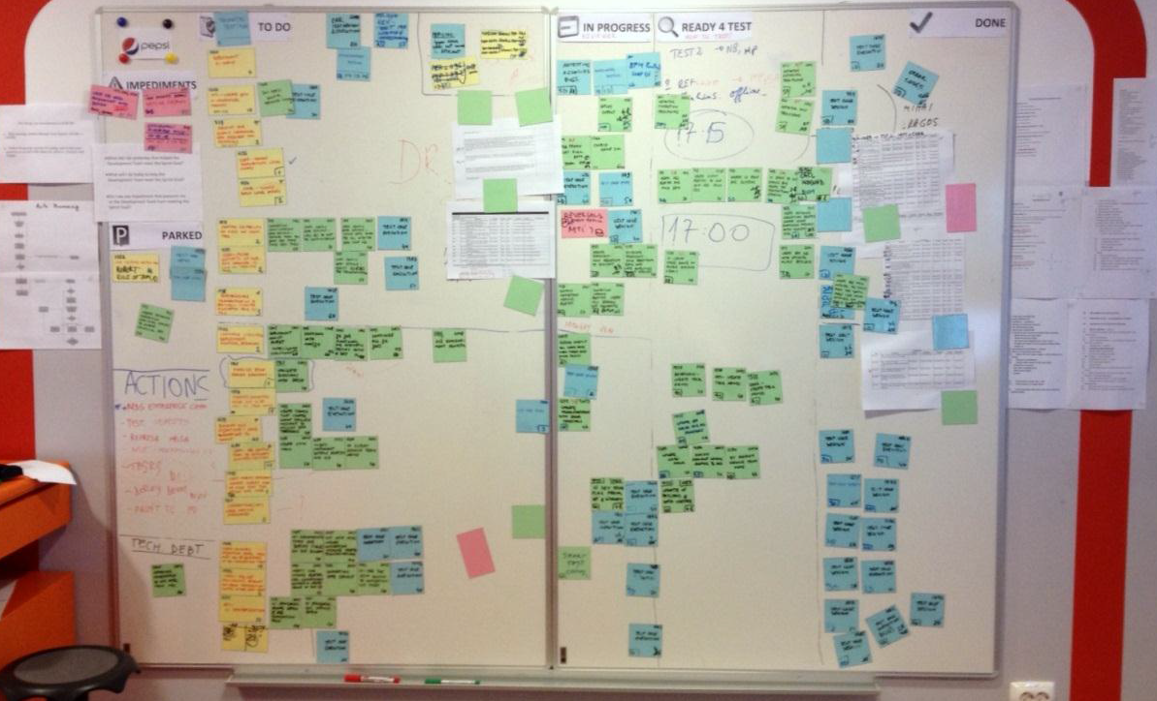
Sprint Backlog
WHY
team needs a plan for delivering the product Increment and realizing the Sprint Goal
team needs an artefact to reflect an up-to-date snapshot of the sprint's progress and facilitate the day-to-day planning
team tracks this total work remaining to project the likelihood of achieving the Sprint Goal
Notes:
The Sprint Backlog is the set of Product Backlog items selected for the Sprint, plus a plan for delivering the product Increment and realizing the Sprint Goal. The Sprint Backlog is a forecast by the Development Team about what functionality will be in the next Increment and the work needed to deliver that functionality into a “Done” Increment.
The Sprint Backlog makes visible all of the work that the Development Team identifies as necessary to meet the Sprint Goal.
The Sprint Backlog is a plan with enough detail that changes in progress can be understood in the Daily Scrum. The Development Team modifies the Sprint Backlog throughout the Sprint, and the Sprint Backlog emerges during the Sprint. This emergence occurs as the Development Team works through the plan and learns more about the work needed to achieve the Sprint Goal.
As new work is required, the Development Team adds it to the Sprint Backlog. As work is performed or completed, the estimated remaining work is updated. When elements of the plan are deemed unnecessary, they are removed. Only the Development Team can change its Sprint Backlog during a Sprint. The Sprint Backlog is a highly visible, real-time picture of the work that the Development Team plans to accomplish during the Sprint, and it belongs solely to the Development Team.
Monitoring Sprint Progress
At any point in time in a Sprint, the total work remaining in the Sprint Backlog can be summed. The Development Team tracks this total work remaining at least for every Daily Scrum to project the likelihood of achieving the Sprint Goal. By tracking the remaining work throughout the Sprint, the Development Team can manage its progress

Slide 54
Sprint Backlog
WHAT
a plan that changes in progress can be understood in the Daily Scrum
an artefact build by the team for the team; to help the team not to be a reporting tool for anyone in organization
contains the needed level of detail established by the team to achieve the goal
a subset of User Stories (broken down in tasks) selected by the team during the Sprint Planning meeting and represents the workload forecasted at the beginning of the Sprint
living document
if the Product Backlog focuses on WHAT and WHY, Sprint Backlog focuses on part of WHAT and HOW
an item from the Sprint Backlog can have: a description, an estimation, business value, Jira us reference, task reference, team member assigned, an estimation, reviewer name
HOW
during Sprint Planning, team members select a number of items from Product Backlog based on priority and PO advice and breaks them into tasks
Notes:
a plan that changes in progress can be understood in the Daily Scrum.
an artefact build by the team for the team; to help the team not to be a reporting tool for anyone in organization
contains the needed level of detail established by the team to achieve the goal
a subset of user stories (broken down in tasks) selected by the team during the Sprint Planning Meeting and represents the workload forecasted at the beginning of the Sprint living document
If the Product Backlog focuses on WHAT, sprint backlog focuses on part of WHAT and HOW
an item from the Sprint Backlog can have: a description, an estimation, business value, Jira us reference, task reference, team member assigned, an estimation, reviewer name

Slide 55
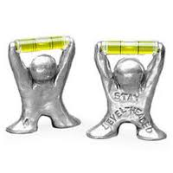

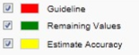
How a Successful Sprint Looks Like
Level Headed
constant yellow estimation line
bit wiggly but keeping the same course
Land your Plane
the green progress line comes closely & above the red ground line
bit wiggly but steadily coming towards the ground in the end

Slide 56



How a Challenged Sprint Looks Like
significantly uncertain yellow estimation line
Moving target
the Sprint Goal is not fixed, stories or acceptance criteria are being added after the sprint started
Confusion
the team does not understand the work in Sprint and constantly finds out more
Taking Off
the green progress line keeps rising above the red ground line
the team will miss the Sprint Goal or is adding more, more work
Sinking
the green progress line keeps plummeting below the red ground line
the team overestimated and is finishing faster, they need more work
added to the Sprint Goal
Notes:
Yellow: re-estimations and/or more stories / tasks added in the Sprint Backlog after the start of the sprint
Confusion sign = the team does not understand the work in sprint and constantly finds out more OR
Moving Target sign = the Sprint Goal is not fixed, stories or acceptance criteria are being added after the sprint started

Slide 57
Essential Scrum
Intro
Team
Ceremonies
Artifacts
Product Backlog
Sprint Backlog
Product Increment
Retrospective Notes

Slide 58
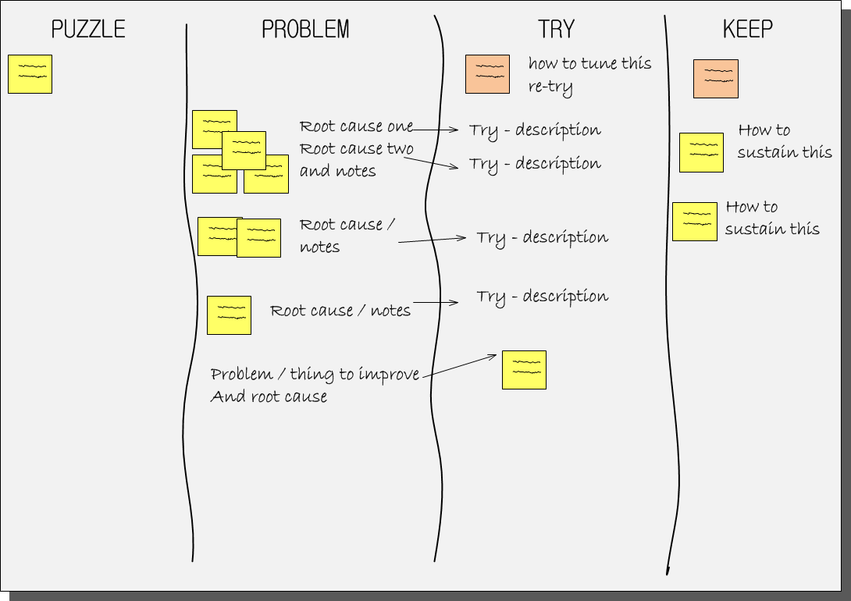
Retrospective Notes and Actions
WHY
it is the key of the adaptive process
the goal is consensus on what to do next
it's a constant reminder of the need to continuously improve, to always be moving forward
helps team - even great ones - keep improving
WHAT
the expected output is two lists of action items (with stated goal/reason for each action) One for the team (inside) One for the Scrum master (outside: involving the rest of the organization)
how to work more efficiently as a team (The adaptation is at the team level not at the individual level)
Notes:
The Executable Action Items are a very short check list or todo list of suggested ideas, also known as experiments, for improving the performance of the team. This list is derived from a subset of all the issues discovered in the retrospective meeting. The list of open issues are scoped down to a short list of high priority items, less than 3, that the team wants to address in the next iteration.
https://www.cprime.com/2013/01/effective-retrospectives/

Slide 59

















Companies doing Scrum
Notes:
Scrum is used as an Agile practice that delivers software to end users faster, better, and cooler. As the Chief Product Owner at Yahoo observed, coolness is a requirement at Google, Yahoo, and most software game companies. Scrum supports a creative approach to development of complex and innovative systems and it scales to large numbers of developers. It is used on some of the world's largest projects at companies like British Telecom or Siemens because of high productivity with large distributed and outsourced development teams. It is the only software development process that has demonstrated linearly scalable when adding resources to large projects. In a properly implemented Scrum, productivity per developer stays the same when adding resources, a phenomena never seen before in software development.
The most profitable software product ever created (Google Adwords) is powered by Scrum and the most productive large project with over a million lines of code (SirsiDynix) used a distributed, outsourced Scrum implementation. CMMI Level 5 companies cut costs in half with Scrum while simultaneously improving quality, customer satisfaction, and the developer experience (Systematic Software Engineering). At the same time, Scrum remains the process of choice in small entrepreneurial companies where it has its roots. OpenView Venture Partners in Boston invests only in Agile organizations and Scrum is the core process used in their portfolio companies.
Scrum is now used by companies large and small, including Yahoo!, Microsoft, Google, Lockheed Martin, Motorola, SAP, Cisco, GE, CapitalOne and the US Federal Reserve. Many teams using Scrum report significant improvements, and in some cases complete transformations, in both productivity and morale. For product developers – many of whom have been burned by the “management fad of the month club” – this is significant. Scrum is simple and powerful.
http://jeffsutherland.com/ScrumPapers.pdf

